Slide 1






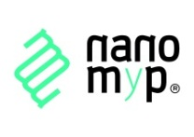



Integrated In Situ Chemical MApping Probes
http://www.schema-ocean.eu
Paolo D’Angelo
FP7-OCEAN-2013 - SCHeMA: integrated in Situ Chemical MApping Probes

Slide 2
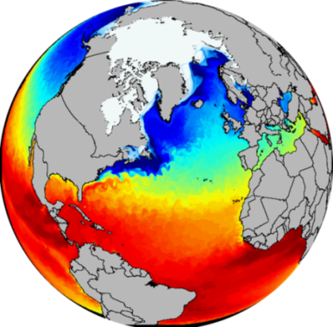
Background
Bring together and interconnect Marine Data from different sources with the aim of:
Blue Growth
harnessing the potential of Europe’s sea and water basins for Job, Value and Sustainability (5 key areas: renewable energy, mineral resources, aquaculture, biotechnology, tourism)
creating new job opportunities
Marine Knowledge 2020
improving our understanding of how the seas behave
(71% of Earth surface is water)
helping industry, public authorities and researchers find the data and make more effective use of them to develop new products and services
Marine Strategy Framework Directive and Water Framework Directive
monitor and protect the marine environment
comprehensive compulsory monitoring of the Marine environment beyond geographical limits and borders
Changes in one country’s water affect those of its neighbours
http://ec.europa.eu/maritimeaffairs/policy/marine_knowledge_2020/
Marine Strategy Framework Directive (2008/56/EC)

Slide 3




Ocean of Tomorrow
European Commission 7th Framework Programme, OCEAN-2013.2 call
The Ocean of Tomorrow 2013
COMMON SENSE: Cost-effective sensors, interoperable with international existing ocean observing systems, to meet EU policies requirements.
NeXOS: The general objective of NeXOS is to develop new cost-effective, innovative and compact integrated multifunctional sensor systems (ocean optics, ocean passive acoustics, and sensors for an Ecosystem Approach to Fisheries (EAF)).
SENSE OCEAN: SenseOCEAN draws together world leading marine sensor developers to create a highly integrated multifunction and cost-effective in situ marine biogeochemical sensor system.
SCHeMA: integrated in Situ Chemical MApping Probes.

Slide 4
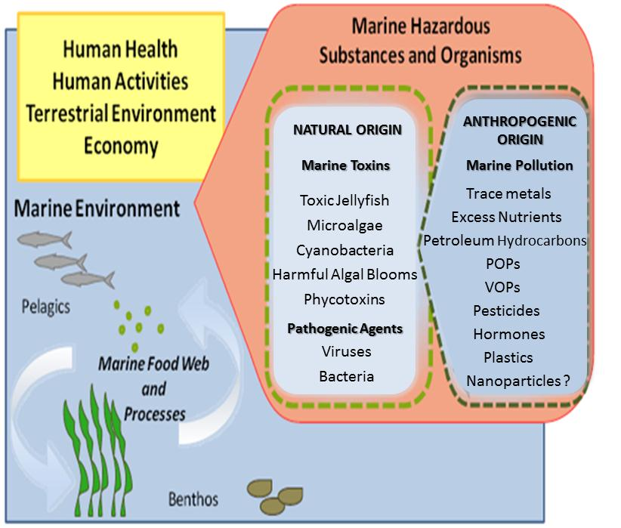

SCHeMA Objectives
To provide an open and modular sensing solution for in situ high resolution mapping of a range of anthropogenic and natural chemical compounds coupled to master bio-physicochemical parameters
Key targets are chemicals that may:
adversely affect marine ecosystems, living resources and ultimately human health
have feedback (synergic) interaction
a range of trace metals from Cd(II) to Cu(II)
a range of nutrients
species relevant to the carbon cycle
volatile organic constituents (VOCs)
relevant algae species and toxins
An ad-hoc ICT wireless networking solution
& web-based data information system
Plug-and-play adaptive wireless chemical sensor probe network
gathering detailed spatial and temporal information (second to hours)
system localization, status & (re)configuration
data management & access

Slide 5
SCHeMA Consortium
The consortium is composed by 9 partners from 6 different countries and it represents a multi-sectorial partnership between:
3 SMEs: Idronaut (Italy), nanoMyP (Spain), ETT (Italy)
5 Universities: UNIGE (Switzerland), UULM (Germany), TUGRAZ (Austria), UBX1 (France), UNIGe-IT (Italy)
1 Federal Institute of Technology: EPFL - SAMLAB (Switzerland)
All partners share leading expertise in one or two sectors

Slide 6
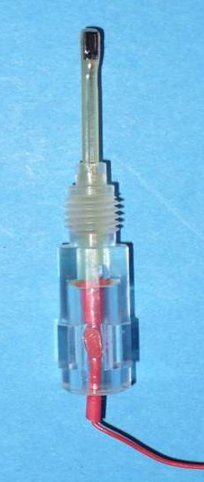
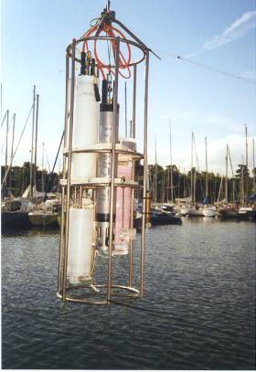
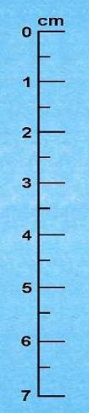
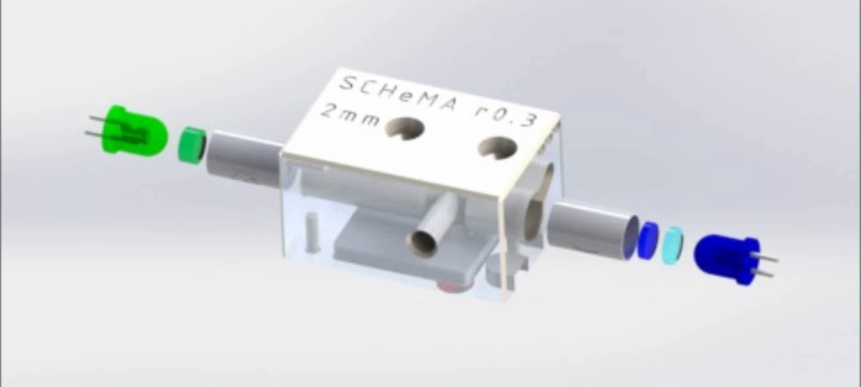
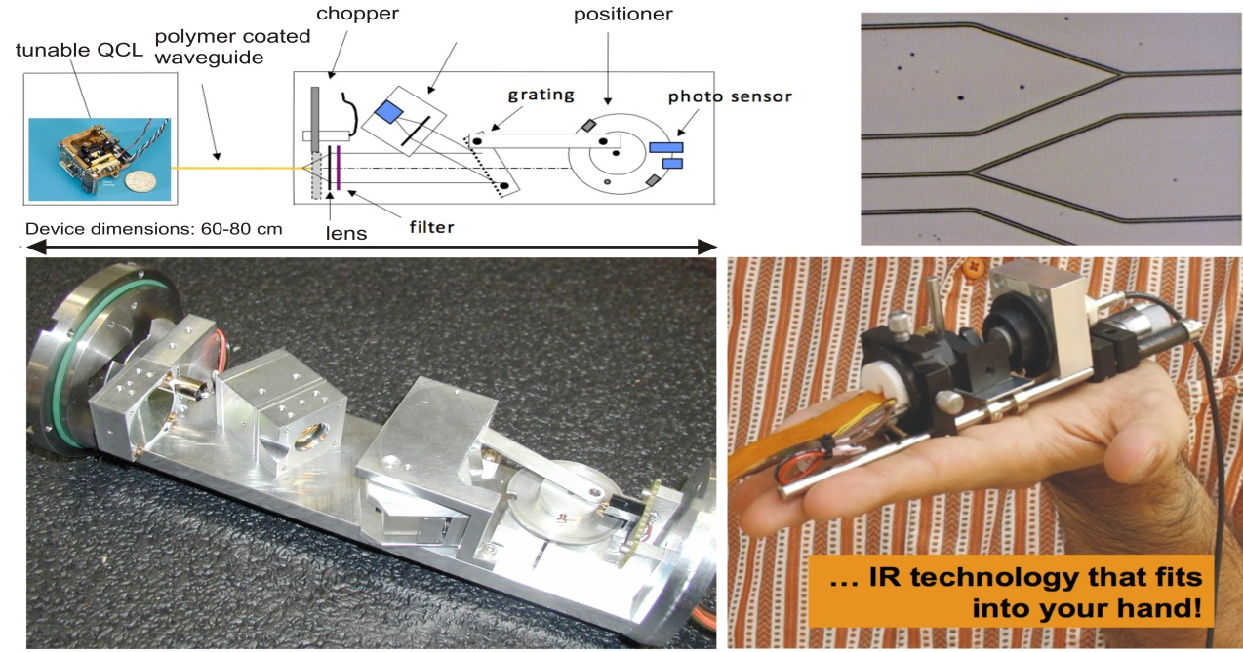
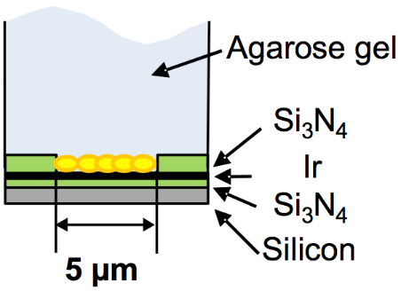
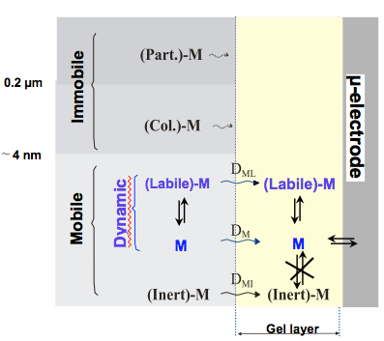
SCHeMA sensors
What | Targets | Developers
Optochemical mid-infrared sensor probe | VOCs | UULM, nanoMyP
Multi-channel optical sensor modules | relevant algae species; biotoxins | TUGRAZ, EPFL, UNIGE
Multi-channel electrochemical (GIME) sensor probes | a range of trace metals and nutrients, as well as species relevant to the carbon cycle | UNIGE, IMT, Idronaut, nanoMyP

Slide 7
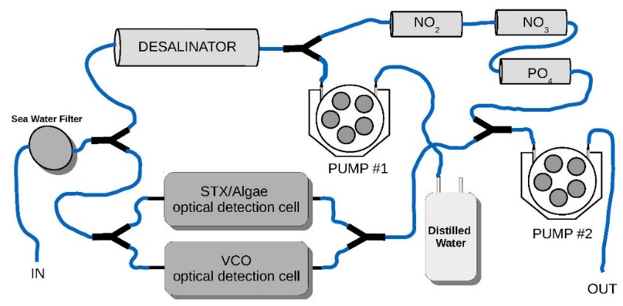
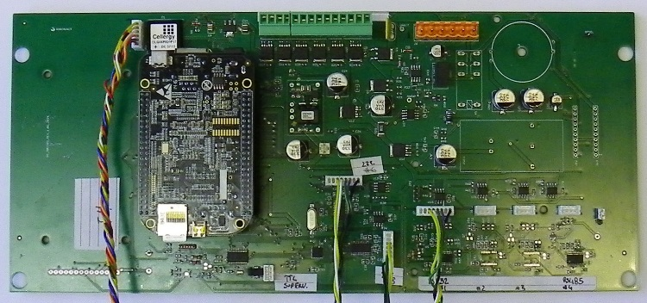
SCHeMA Submersible Probe
Design and Development of:
Sensors electronic interface
Management and processing digital electronics
Software and data interfaces, data processing algorithms
Communication protocols
Mechanics of the submersible probes
Power supply, and connection methods
Development of a Network Controller (NC) for the management of the different modules and communication with the land station

Slide 8
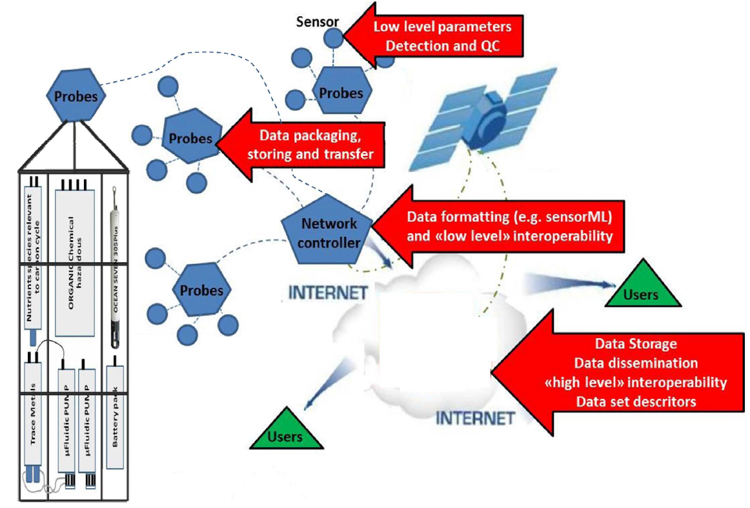
ICT Solution
Web-based networking solutions
localization, system reconfiguration,
data transfer, formatting, storage, analysis
Web-based data information system
data bank storage, access
Easy interoperability with national, regional
and local marine and observation systems
e.g.: EMODnet , EuroGOOS, CMEMS,
SeaDataNet, ROOSs, SEIS….

Slide 9
ICT Solution
Communication protocols for:
Information about the probes
Data acquired (temperature, salinity, etc…)
Errors or warnings
Configurations
Since there are:
Different probe/sensor type
Different data acquired
Different error type that should be monitored
Different configuration mechanism
COMMON
COMMUNICATION
STANDARD
Data download:
Easy access
Probes and Observation Metadata
Different data Format (xml, csv, json, etc..)
Since there are:
Different client needs
Different type of probes and data
COMMON
INTERROGATION
STANDARD

Slide 10

OGC Sensor Web Enablement
OGC Sensor Web Enablement (OGC-SWE) defines standards to exploit Web-connected sensors and sensor systems, such as oceanographic instruments and more
The OGC-SWE enables the discovery, exchange, and processing of sensor observations and tasking of sensor systems by means of 3 standards XML encodings (SensorML, O&M, TML) and 4 standards web service interfaces (SOS, SAS, SPS, WNS):
Sensor Observation Service (SOS): data and metadata on sensors and observations
Sensor Planning Service (SPS): data and metadata on sensor configuration
Sensors Alert Service (SAS): data and metadata on alerts and errors from the sensors and probes

Slide 11
SCHeMA SOS
Development of a light SOS interface fully integrated with ETT observing system (used also for EMODnet Physics), easier to mantain, manage and deploy
SOS 1.0 (stable version in 2014, lots of documentation and examples – ISTSOS, IOOS, etc..)
  Core profile (GetCapabilities, DescribeSensor, GetObservation)
  Transactional profile (RegisterSensor, InsertObservation)
Custom methods for registering alarms and changing sensor configuration
  RequestSP
  InsertError
Easier and faster to implement in the framework of the project instead of using full SAS (Sensor Alert Service) and SPS (Sensor Planning Service)

Slide 12
SCHeMA SOS
SOS Interface
Web service implementing Core and Trasactional profile methods
Notification Manager
Process to inform sensor owners of errors raised by the probes (email/SMS)
Web Interface
Data visualization
Dashboard
Sensor Planning
Data Upload/Download
Database
Storage
System still under development: more feature will be developed in the next 6 months

Slide 13
From Sensors to SOS
Communication between NC and sensors with proprietary protocol
Communication between NC and Land Station using SOS interface
RegisterSensor (sensorML) → sensor registration
InsertObservation (Observation & Measurements) → data transfer

Slide 14
From Sensors to SOS
The NC sends XML requests to the land station:
First it registers all the attached probes
Then it sends observation at defined times and it checks if new sensor configuration has been deployed in the server
If any error occur, an insertError notification is sent to the Land station
Network Controller
Land Station
RegisterSensor: I’m the Schema NC, can I register to your sytem?
Response: Yes, you’re registered as sensor Number 2123
InsertObservation: Hi I’m 2123, here is some temperature data
Response: Thank you 2123 your data has been received and stored
RequestSP: Hi I’m 2123, have you new instructions for me?
Response: Yes 2123, here are the new configuration parameters
InsertError: Hi I’m 2123, my battery is low can you help me?
Response: Yes 2123, your request has been sent to the probe manager

Slide 15
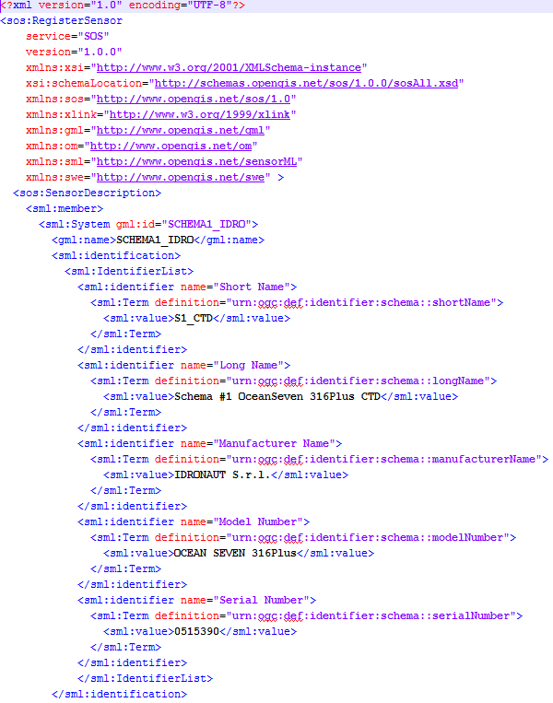
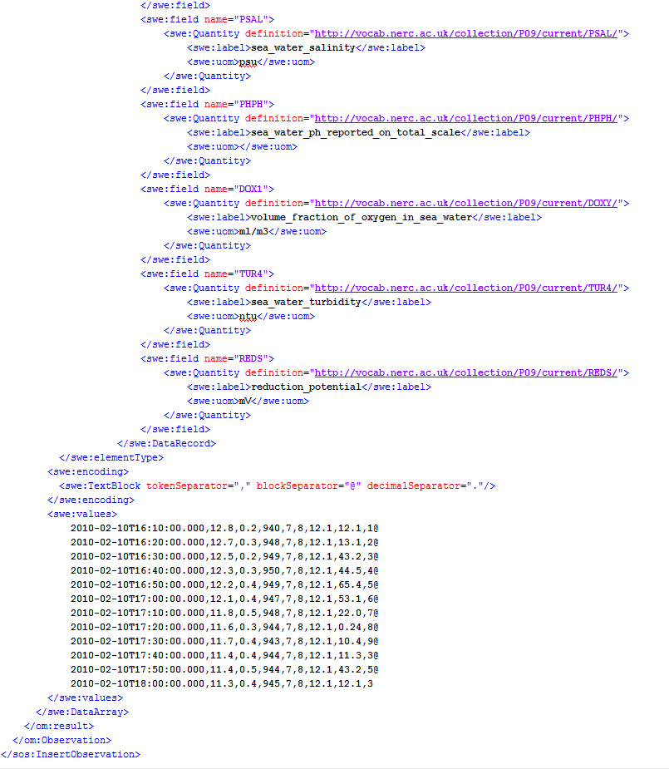
From Sensors to SOS
RegisterSensor
InsertObservation

Slide 16
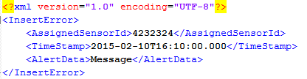

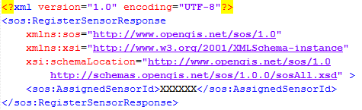

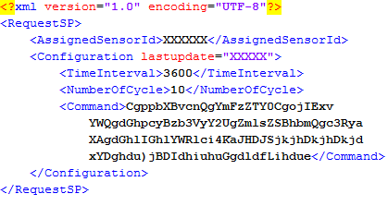
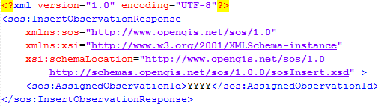
From Sensors to SOS
InsertError
RequestSP
RegisterSensor response
InsertError response
RequestSP response
InsertObservation response

Slide 17
From SOS to Clients
Retrieve information about the SCHeMA SOS service instance, including metadata about all the SCHeMA probes, experiments and operations via HTTP/GET and HTTP/POST request methods
Land Station
GetCapabilities: What service do you provide?
Client
Response: service metadata (Capabilities)
DescribeSensor: what are the characteristics of sensor YYZ?
Response: sensor metadata (SensorML)
GetObservation: give me data recorded by sensor YYZ,
Response: observed data (O&M)
http://dataportal.schema-ocean.eu/service/wssos.asmx/SOS?service=SOS&request=GetCapabilities&version=1.0.0
http://dataportal.schema-ocean.eu/service/wssos.asmx/SOS?service=SOS&request=DescribeSensor&version=1.0.0&outputFormat=text/xml&procedure=urn:ogc:def:procedure:schema::S1_TMSM-2
http://dataportal.schema-ocean.eu/service/wssos.asmx/SOS?service=SOS&request=GetObservation&version=1.0.0&observedProperty=sea_water_temperature&offering=exp-14&responseFormat=text/xml&procedure=urn:ogc:def:procedure:schema::S1_TMSM-2

Slide 18
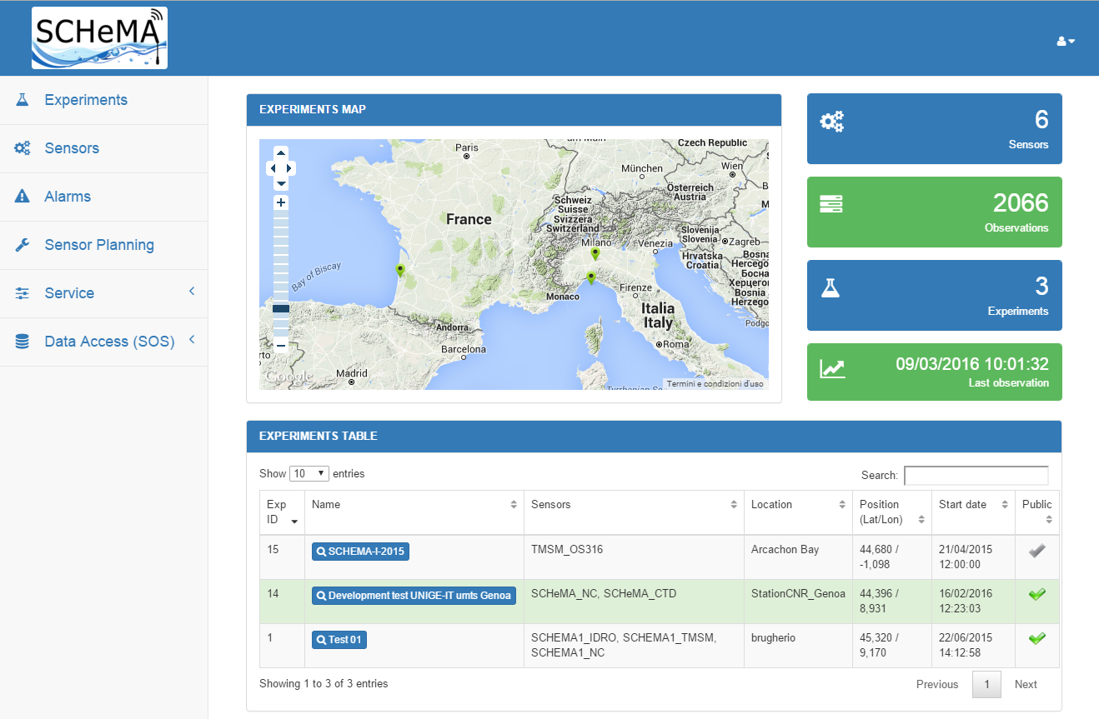
Web Interface
The SCHeMA Web Front-end allows the user to:
manage probes/sensors
view stored observations and metadata
handle alarms and sensor configurations
System under developement @ http://dataportal.schema-ocean.eu

Slide 19
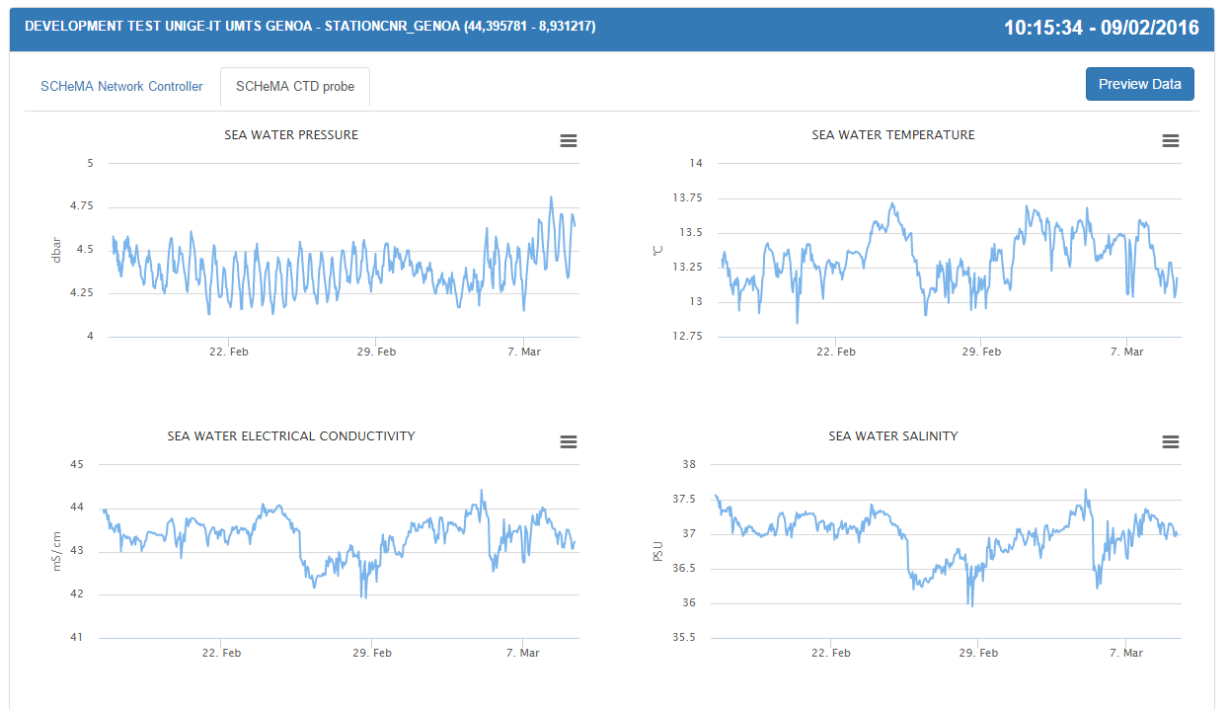
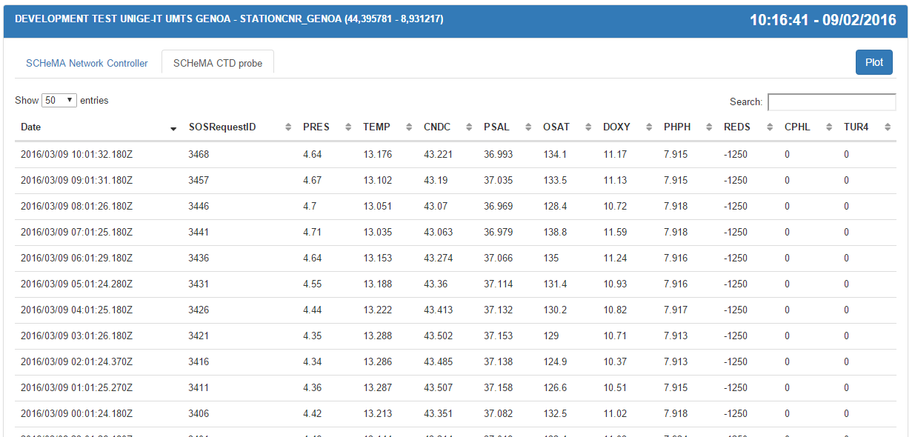
Web Interface
Data Visualization
Sensor Management
Alarm Management
User Management
Dashboard
Data Access

Slide 20
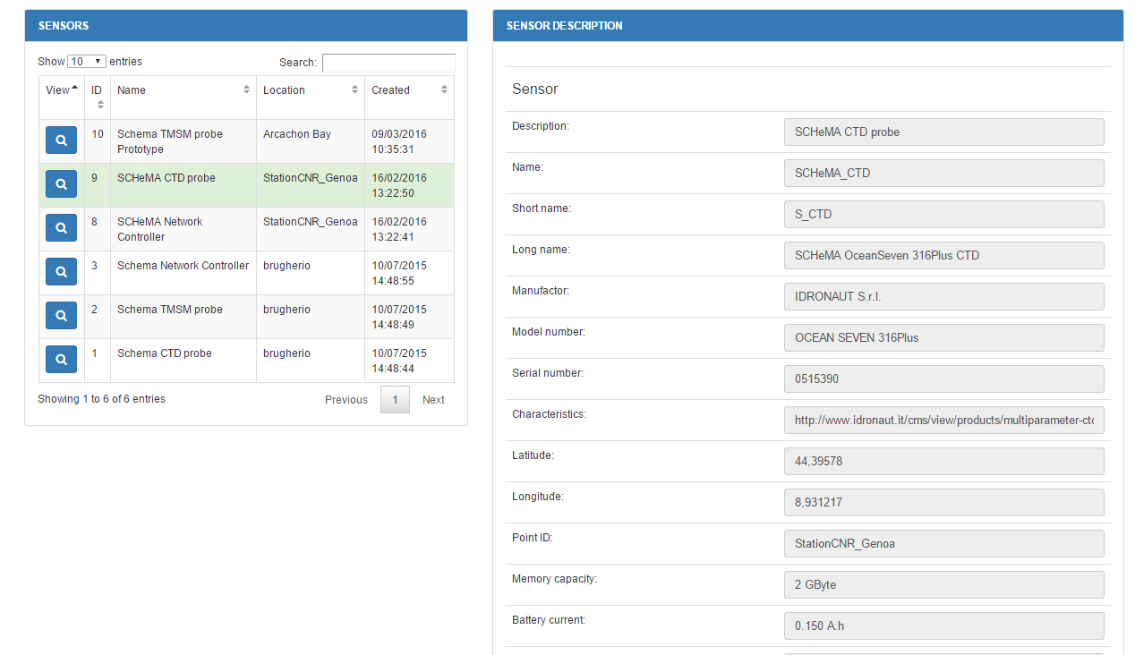
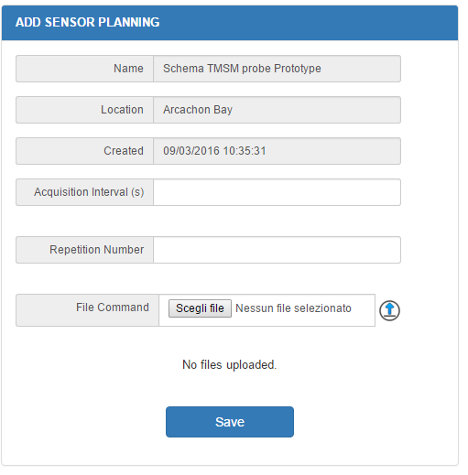
Web Interface
Data Visualization
Sensor Management
Alarm Management
User Management
Dashboard
Data Access

Slide 21
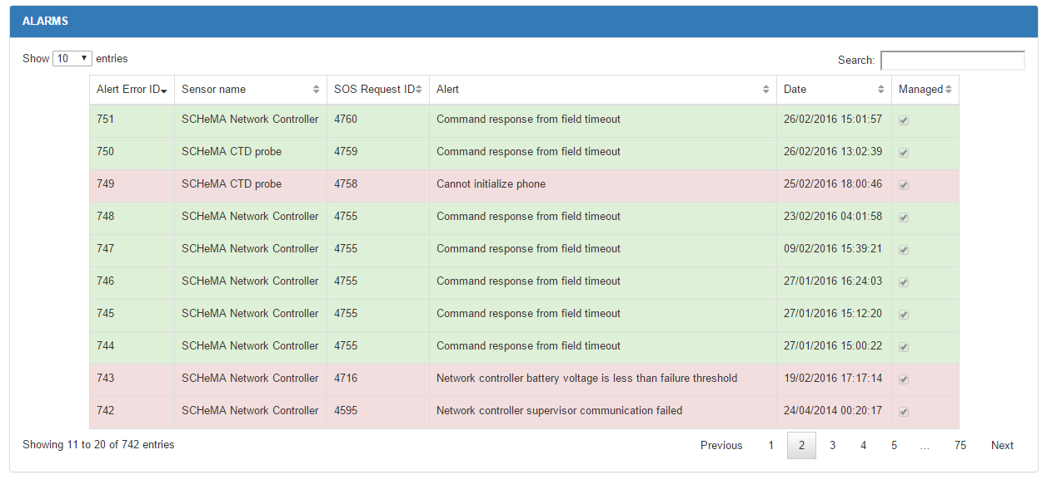
Web Interface
Data Visualization
Sensor Management
Alarm Management
User Management
Dashboard
Data Access

Slide 22
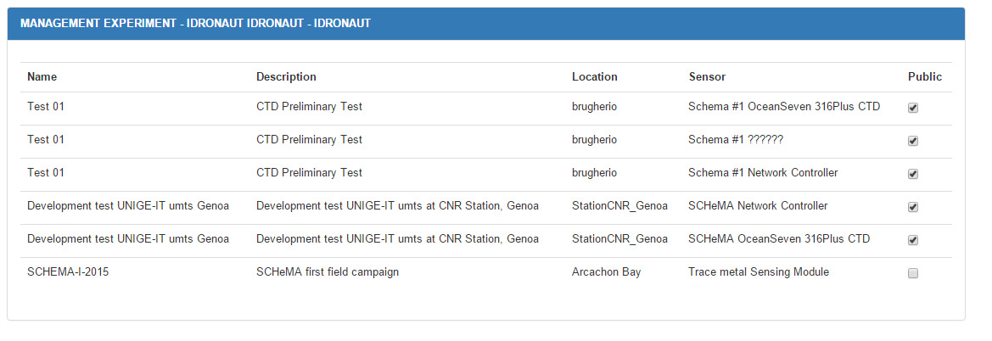
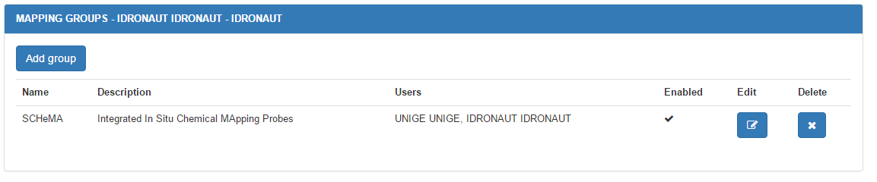
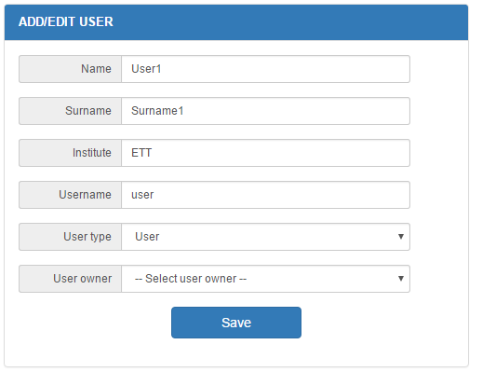
Web Interface
Data Visualization
Sensor Management
Alarm Management
User Management
Dashboard
Data Access

Slide 23
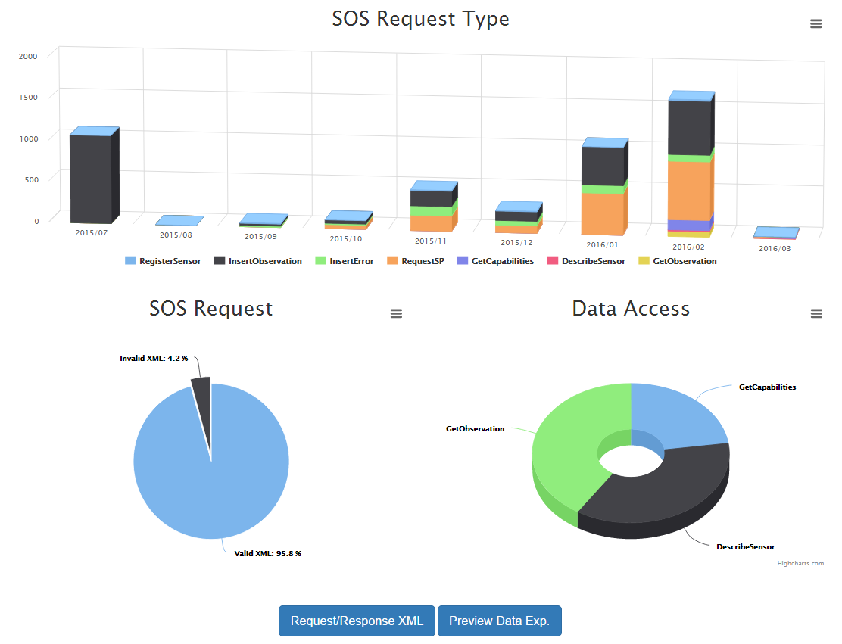
Web Interface
Data Visualization
Sensor Management
Alarm Management
User Management
Dashboard
Data Access

Slide 24
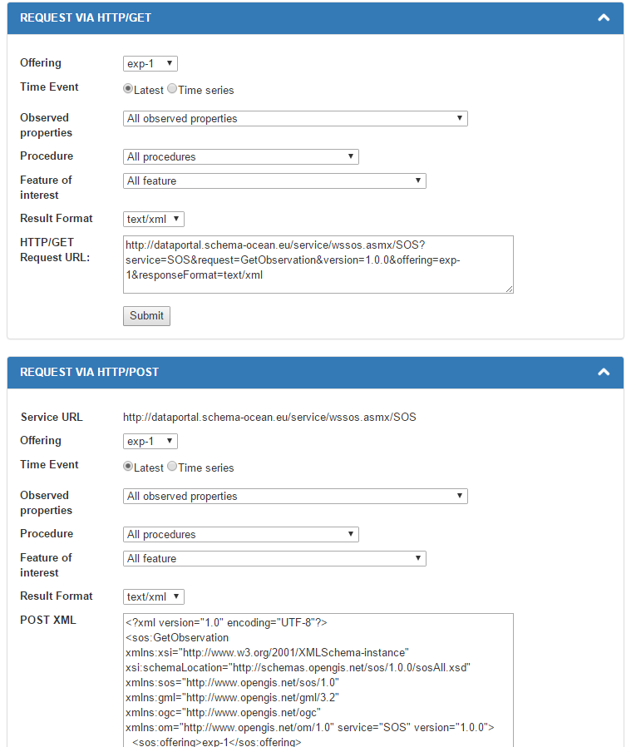
Web Interface
Data Visualization
Sensor Management
Alarm Management
User Management
Dashboard
Data Access

Slide 25
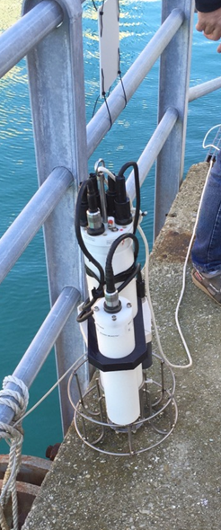
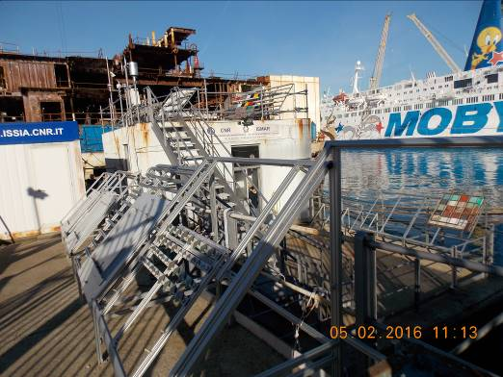
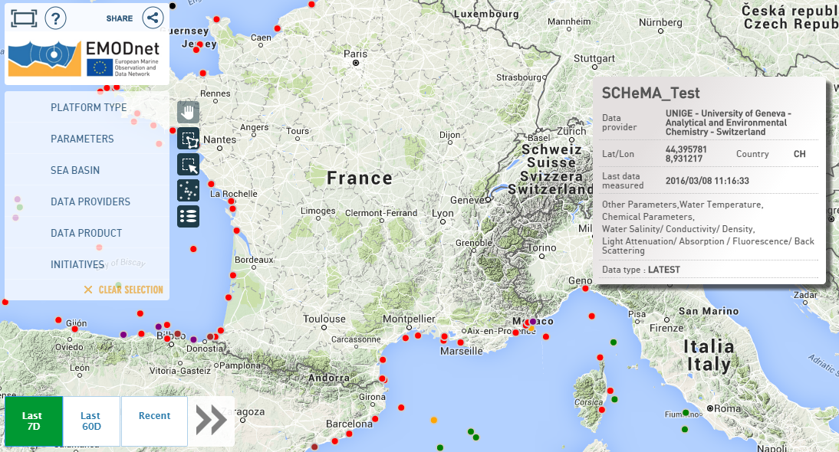
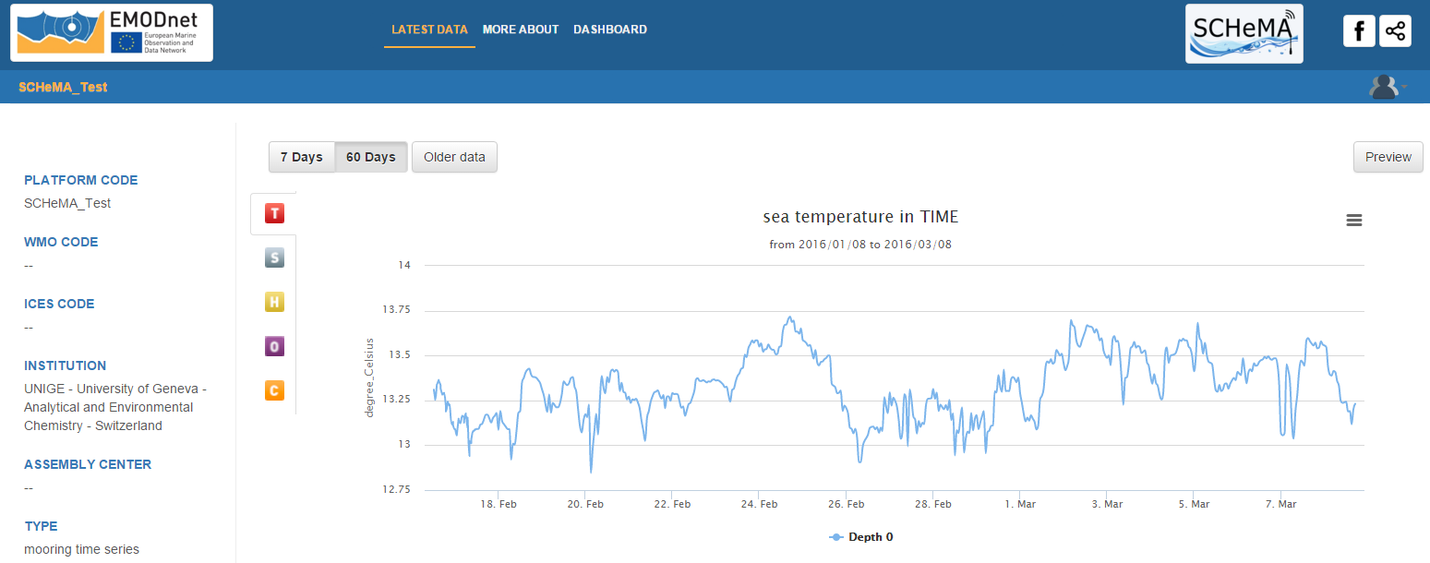
Interoperability
Interrogating the SCHeMA SOS methods, Institute, Local-Regional Assembly Center and hence EMODnet Physics are able to collect in near-real time the SCHeMA probe data (current preliminary test field at Genoa harbor, running since mid February)
EXPERIMENTAL MARINE STATION (SMS) / ISMAR - GENOA
EMoDnet Physics map
Sea water temperature

Slide 26
Discussion
Possible discussion topics:
Vocabularies and Classifications
Unique platform identifier
Security and protection (SOS transactional profile)
…

Slide 27
Contacts
Contacts
University of Geneva – Marie-Louise Tercier Waeber (PC) - Marie-Louise.Tercier@unige.ch
Idronaut s.r.l. - Fabio Confalonieri - idronaut@idronaut.it
University of Ulm - Boris Mizaikoff - boris.mizaikoff@uni-ulm.de
University of Graz - Ingo Klimant - klimat@tugraz.at
EPFL – SAMLAB - Peter van der Wal - peter.vanderwal@epfl.ch
nanoMyP - Angel Valero - avalero@nanomyp.com
University of Bordeaux - Jörg Schäfer - jorg.schafer@u-bordeaux.fr
ETT S.p.A. – Antonio Novellino – antonio.novellino@ettsolutions.com
University of Genoa – Paolo Povero - povero@unige.it
Thank you for your attention
http://www.schema-ocean.eu

