Slide 1



EarthCube Integrative Activities:
Cross-Domain Observational Metadata Environmental Sensing Network (X-DOMES)
September 2015 – August 2017
Focusing on Sensor Metadata Creation; Data Quality Assessment; Sensor Metadata Interoperability; Content Management using community adopted standards
OGC: SWE; SOS; SensorML;
W3C: Semantic Web; RDF; OWL
PI: Janet Fredericks, Woods Hole Oceanographic Institution
Co:Pis Krzyzstof Janowicz (UCSB), Mike Botts, Carlos Rueda (MBARI), Felimon Gayanillo (TAMUCC) & consulting with John Graybeal (MMI)
Oceanology International-SWE Marine Profile Workshop
March – 2016
Notes:
Back to original slide – can be deleted?

Slide 2
Notes:
Back to original slide – can be deleted?

Slide 3
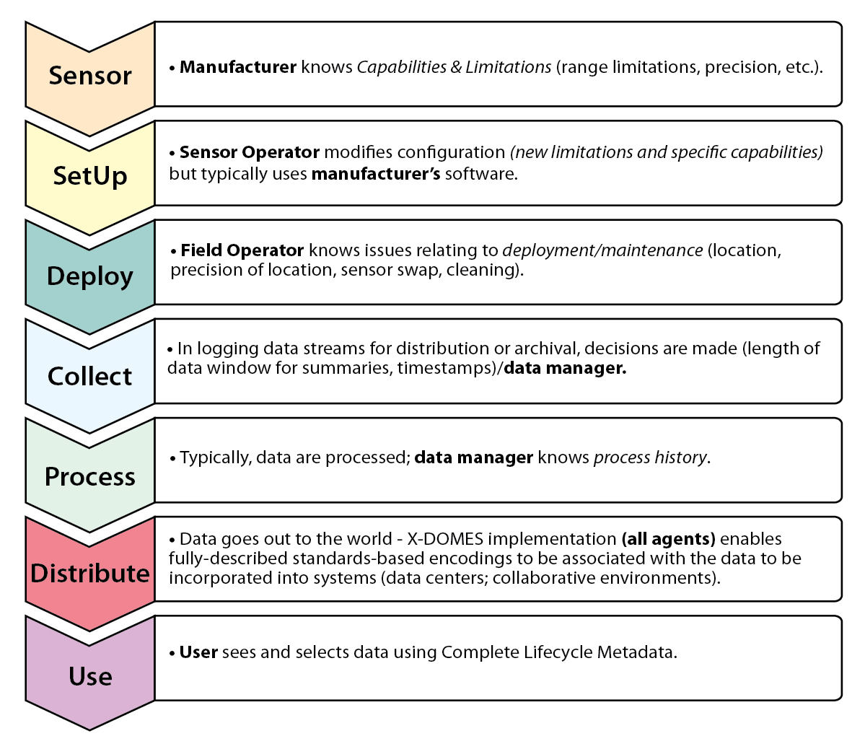

Slide 4
GOAL: two paths
Described well enough for assessment of data for specified use and for a repurposed application
NOAA/NDBC
provides 24/7 QC;
Feeds National IOOS backbone;
NOAA/NODC
provides national archival for valued data sets (they can determine the value)
Sensor Manufacturers and domain experts develop sensor and processing descriptions in standards-based encodings
NSF/OOI; NSF/R2R; NSF/BCODMO
provides community-based integration with tools and QC, along with discovery and mapping opportunities
Converters;
QC algorithms; vocabularies & ontologies; analysis and visualization tools
Real-time Rapid Response
integration can be accomplished quickly and reliably by communicating metadata in standards-based systems
Research and survey data served with associated metadata in a community-adopted, standards-based framework
Modeling
using translation tools from the cloud, modelers have access to a broader source of information
ANYONE
By fully describing data, sensors and processing with associated provenance, data can be discovered and explored for any program
Standards-based
(machine-to-machine harvesting)
User-based Frameworks
Notes:
Back to original slide – can be deleted?

Slide 5
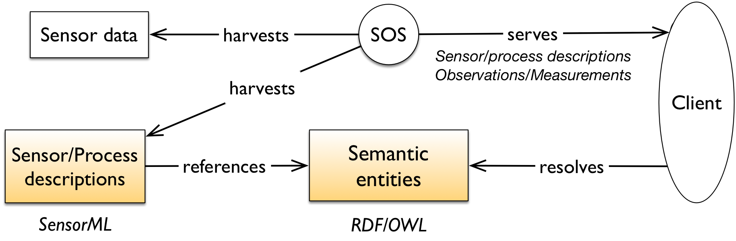
Standards in Sensor Metadata Interoperability
(q2o.whoi.edu with funding from NOAA-IOOS 2007-11)
GetCapabilities
GetObservation
O&M
SensorML
DescribeSensor
Notes:
Back to original slide – can be deleted?

Slide 6
Standards in Sensor Interoperability
Sensor Manufacturer creates content utilizing OGC and W3C Standards (SensorML and OWL/RDF) on the WWW
Sensor MFGR
SensorML
OWL/RDF Vocabularies
Content describes information needed to configure sensor; conduct quality control and describe sensing and processing technologies
Operations Management
Data Management
SENSOR

Slide 7
Operations Management System harvests web-based SensorML (to parse content needed for PUCK; configuration, identification and connection)
WWW
Sensor MFGR
SensorML
OWL/RDF Vocabularies
puck
PUCK is an OGC Adopted Standard – see SOSC website
SENSOR

Slide 8
MAKE IT EASY – No one wants to look at or edit XML!
Notes:
Back to original slide – can be deleted?

Slide 9
Also – utilize SWE 2.0 Inheritance – For EXAMPLE:
http://www.sensorml.com/2.0/mvco/MVCO_ObservingSystem.xml
has component:
http://www.sensorml.com/2.0/mvco/ADCP_System.xml
which has component:
http://www.sensorml.com/2.0/mvco/sensor/MVCO_Workhorse_1200.xml
which is a typeOf:
http://www.sensorml.com/2.0/mvco/sensor/RDI_Workhorse_1200.xml
Notes:
Back to original slide – can be deleted?

Slide 10
Persistence, Public Access, Versioning and Discoverability
Sensor-related vocabularies can be registered and referenced from the SensorML documents (capabilities exist and can be utilized within a number of communities, including:
  MMISW.ORG/ORR , ESIP (http://esipsw.org/orr/#), SENSORML.COM and XDOMES.ORG
SensorML documents will be also be registered (this capability is being developed within the X-DOMES project)
Notes:
Back to original slide – can be deleted?

Slide 11
ENGAGING THE STAKEHOLDERS
Sensor manufacturers across domains to test and assess the climate of willing participation, ease of use of tools and functionality in the registries, as well as continually evaluating the completeness and understandability of content
Data facilities and EC funded projects to test and assess the impact and ease of integration of the outcomes, e.g. LTER, BCO-DMO, R2R, CUAHSI, GeoLINK, DataONE, CHORDS, BCUBE, COLLAB, NCAR-EOL, EPA
Notes:
Back to original slide – can be deleted?

Slide 12
SUSTAINING A Community to Work with Manufacturers
Developing a community within the ESIP Federation EnviroSensing Cluster http://esipfed.org (workshops July 2016 and 2017)
Participating in the Smart Ocean Sensor Consortium
https://sites.google.com/site/soscsite/
Aligning with the activities of the Research Data Alliance
https://rd-alliance.org/
Working with the Marine Metadata Interoperability Project and utilizing its Ontology Repository & Registry:
http://marinemetadata.org and http://mmisw.org/orr
Coordinating with Ocean Data Interoperability Platform: http://odip.org
THIS PROJECT: http://earthcube.org/groups/x-domes
janet@whoi.edu
Notes:
Back to original slide – can be deleted?

