Slide 1

Vocabularies-SeaDataNet-SenseOCEAN
Alexandra Kokkinaki - NOC- BODC (United Kingdom)
Partly Funded by

Slide 2
Overview
Vocabularies:
What are they and why we need them
NERC Vocabulary Server 2 (NVS2)
NVS2 in SeaDataNet:
Progress Report
Progress on SenseOcean Project

Slide 3
Vocabularies

Slide 4



Free text descriptions
Dataset1 includes Oxygen Concetration (mM) and Air saturation (pecrent) measurements.
Dataset2 includes cO₂ (mmol/L) and air saturation (%) measurements.

Slide 5


Queries?
List datasets measuring O2 in mmol/L
Dataset2
Find datasets that measure percentage of air saturation
No available datasets
Find datasets with observed property Oxygen concentration
No available datasets

Slide 6
Conflicts
Data-level conflicts are caused by differences occurring in data domains due to multiple possible representations and interpretations of similar data
Misspellings
Oxygen
O2
Oxgen
Notes:
One dataset may have a column named ……. And another one called sea temperature.
solves the problem of ambiguities associated with data markup and also enables records to be interpreted by computers
If we define temperature of the water body
Sea temperature
Map them

Slide 7
Controlled vocabularies
In information science controlled vocabulary is a carefully selected list of words and phrases, which are used to tag units of information (document or work) so that they may be more easily retrieved by a search
They are important:
capture expertise in agreed, well-defined descriptions
  enable population of a given field in a metadata model with standardised unambiguous terms
  enable records to be interpreted by computers
  promote consistency and interoperability

Slide 8
NVS2 Vocabulary Server
Machine readable
Discoverable
Interoperable
Concept URIs
Description based in Resource Description Framework (RDF) and (Simple Knowledge Organization System) SKOS
      Vocabularies are Collections
      Each Collection consists of many concepts
      A concept is a term that belongs to a collection
http://vocab.nerc.ac.uk/collection/{XXX}/current/
definition
http://vocab.nerc.ac.uk/collection/{XXX}/current/{XXX001}
preferred label
alternative label
  -204 Vocabularies
  -161.000 terms
  -RESTFul interface
  -NVS2 Search to search for vocabularies and into the vocabularies.
  -NVS2 Editor to edit user vocabularies.
  SeaVox
http://vocab.nerc.ac.uk/collection/P06/current/MMPL/
Mappings
Interlink data with a rich and fast-growing network of other data sources
Notes:
The NERC Vocabulary Server provides access to lists of standardised terms that cover a broad spectrum of disciplines of relevance to the oceanographic and wider community.
Therefore, by using concept URIs form these datasets, you interlink your data with a rich and fast-growing network of other data sources.
It is based on RDF and SKOS (standardized language for Linked data, widely accepted ontology for Knowledge representation)

Slide 9
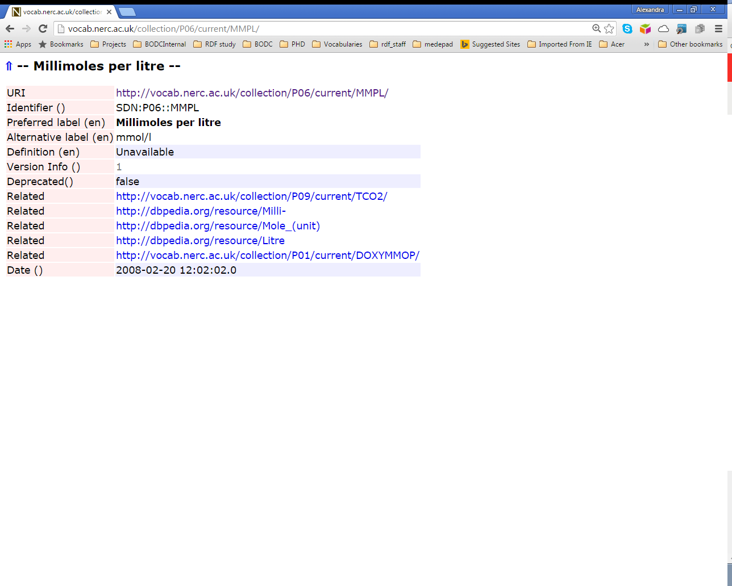

Slide 10
How can Controlled vocabularies help solve “wrong results”
DOXYOP01
MMPL
OXYSZZ02
Dataset1 includes Oxygen Concetration (mM) and Air saturation (pecrent) measurements.
Dataset2 includes cO₂ (mmol/L) and air saturation (%) measurements.
UPCT
DOXYOP01
MMPL
OXYSZZ02
UPCT
http://vocab.nerc.ac.uk/collection/P01/current/DOXYOP01/: DOXYOP01: Concentration of oxygen {O2} per unit volume of the water body [dissolved plus reactive particulate phase] by in-situ oxygen optode
http://vocab.nerc.ac.uk/collection/P06/current/MMPL/:
MMPL:Millimoles per litre
http://vocab.nerc.ac.uk/collection/P06/current/UPCT/: Percent
http://vocab.nerc.ac.uk/collection/P01/current/OXYSZZ02/: Saturation (second sensor) of oxygen {O2 CAS 7782-44-7} in the water body [dissolved plus reactive particulate phase].

Slide 11
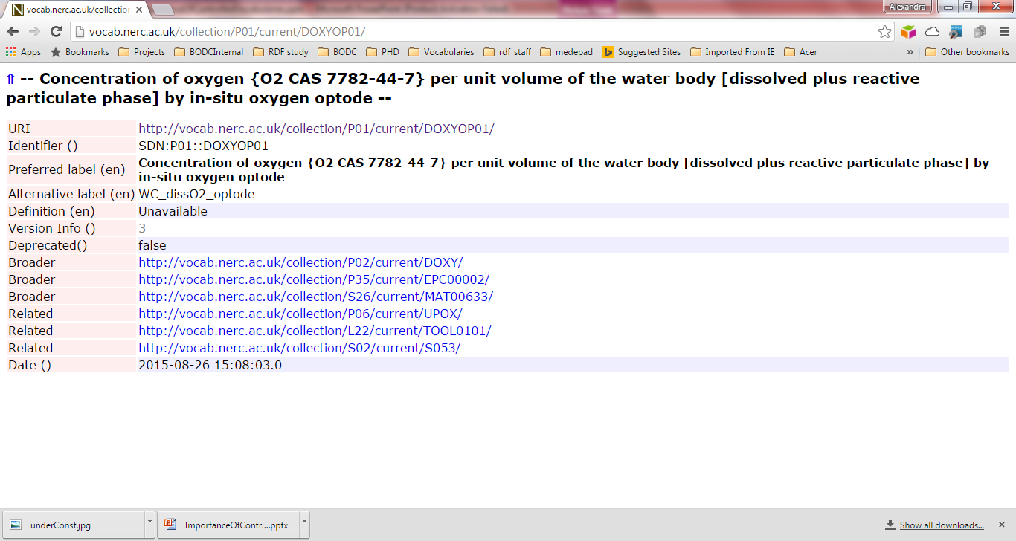

Slide 13
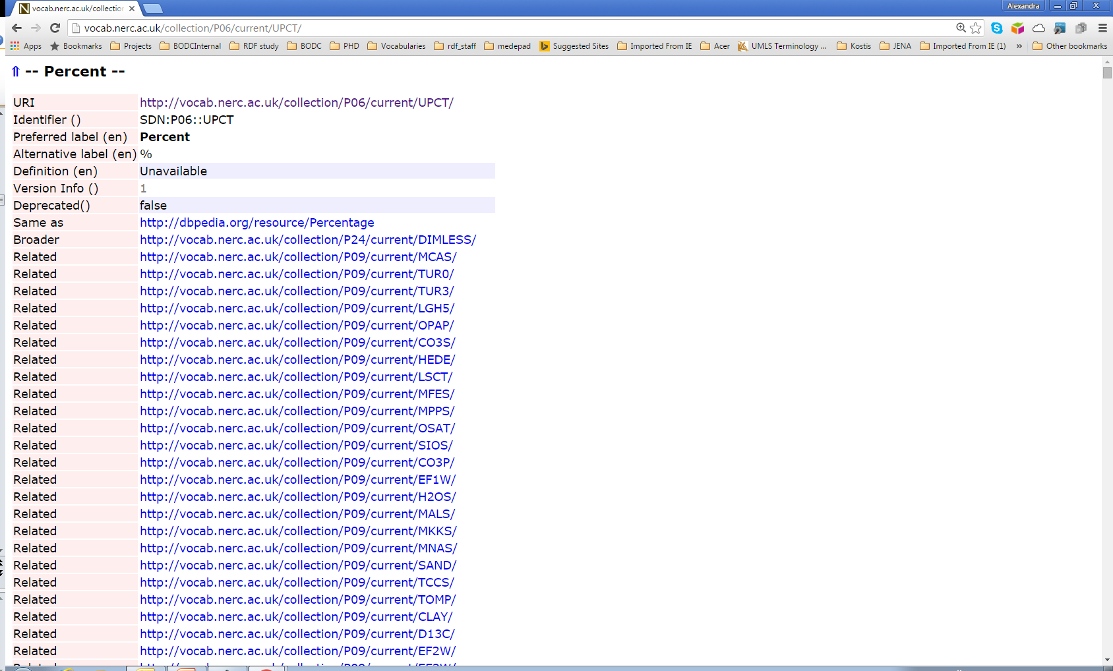

Slide 14
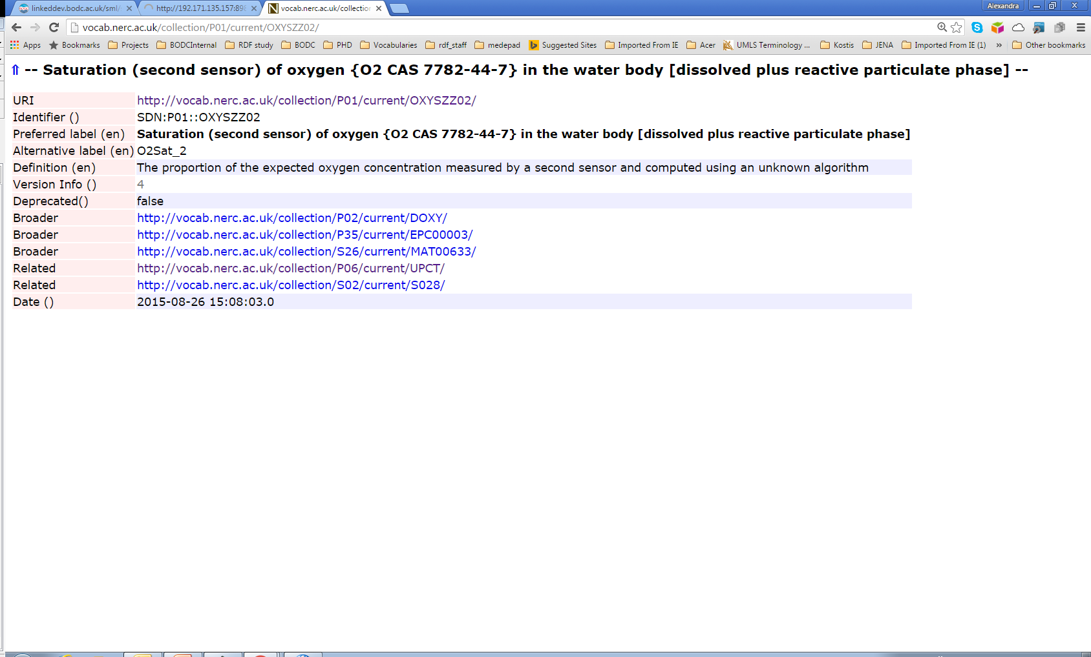

Slide 15
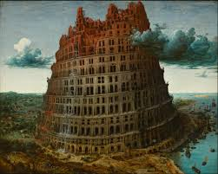
How to choose a Vocabulary
A set of well-known vocabularies has evolved in the Semantic Web community.
Please check whether your data can be represented using terms from these vocabularies before defining any new Vocabularies
How to choose vocabularies
  The URIs are dereferenceable
  The URIs are already linked to URIs from other data sources
  Choose vocabularies that are well governed
    Terms are not deleted
    Updated regularly
    Supported by domain experts ( e.g. Roy Lowry)
    Users can propose their own terms
  If you still have not managed to create your term then:
    Create your own vocabularies, with persistent URIs,
    Create some mappings too.

Slide 16
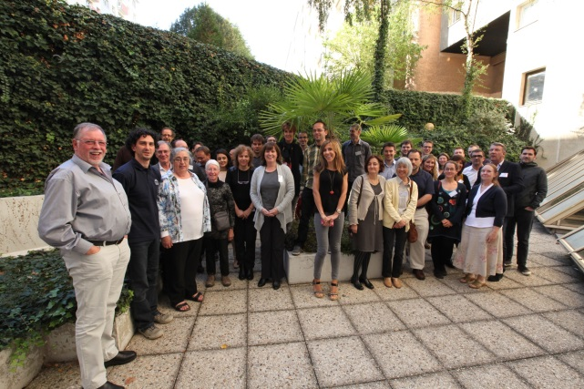
How can you help to be interoperable
Participate in communities to create agreements
Share knowledge and success stories
Participate/organize events/interoperability efforts like:
  SWE Marine Profile (Simon Jirka)
  Oceanology workshop (Dick Schaap)
  ODIP (Ocean Data Interoperability Platform)

Slide 17
Seadatanet NVS services

Slide 18
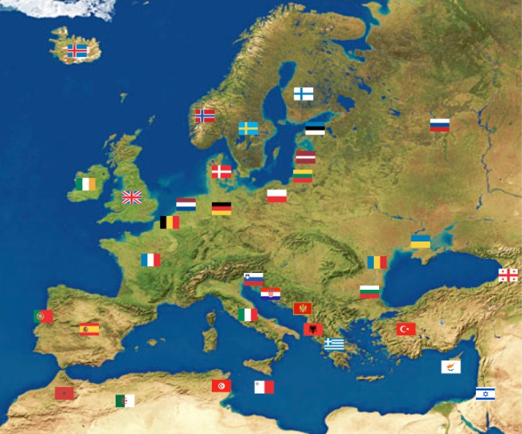



NVS2.0 & EU SeaDataNet-2
Observing systems
Metadata creation
Tool
Datasets
NVS
Cruises
Metadata Discovery
Data
Data
source
Projects
Organisations
Map from http://www.seadatanet.org/Overview/Partners

Slide 19
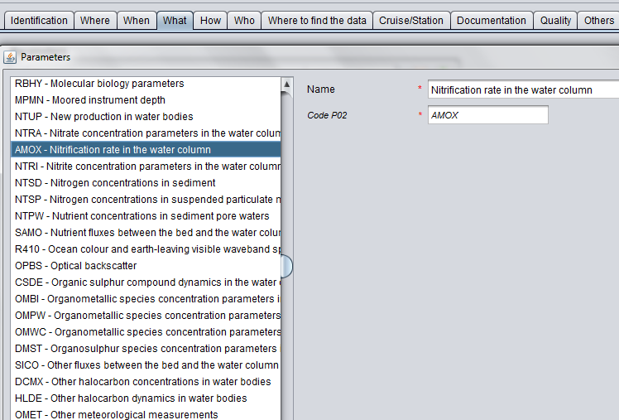
NVS2.0 & EU SeaDataNet-2

Slide 20
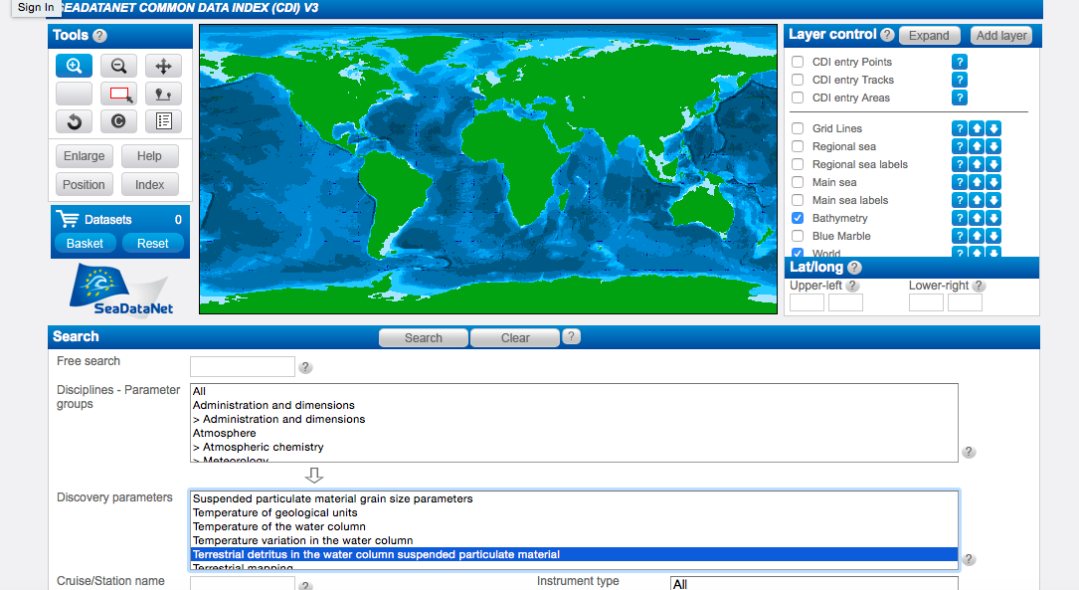
NVS2.0 & EU SeaDataNet-2

Slide 21
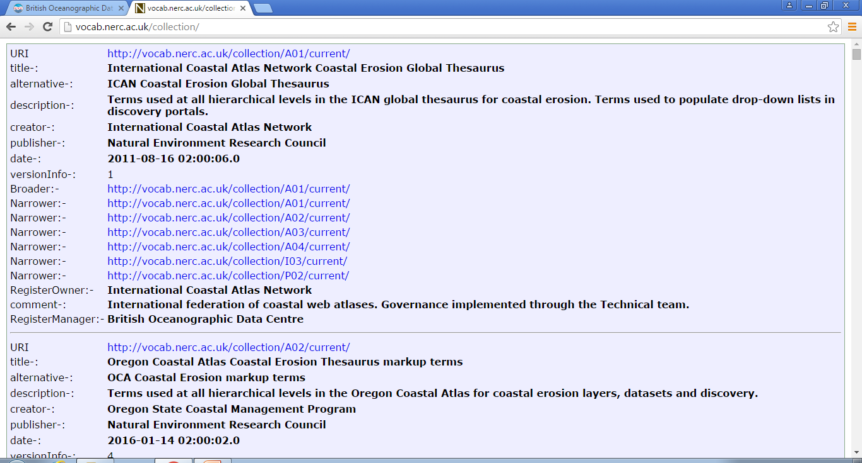

Slide 22
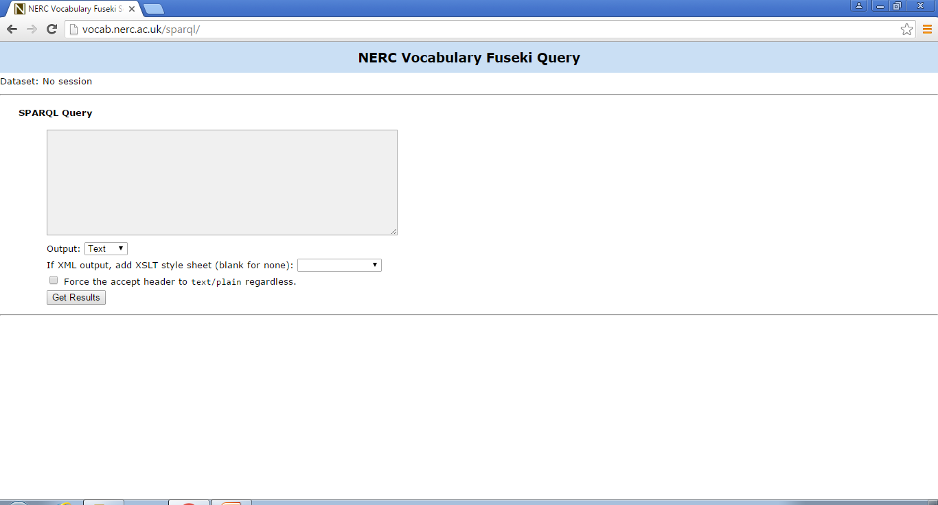
PREFIX skos:<http://www.w3.org/2004/02/skos/core#>
prefix rdf:<http://www.w3.org/1999/02/22-rdf-syntax-ns#>
prefix rdfs:<http://www.w3.org/2000/01/rdf-schema#>
prefix dc:<http://purl.org/dc/terms/>
select * where { ?x a skos:Collection .
?x skos:prefLabel ?prefLabel .
?x skos:altLabel ?altLabel .
?x dc:description ?def .}

Slide 23
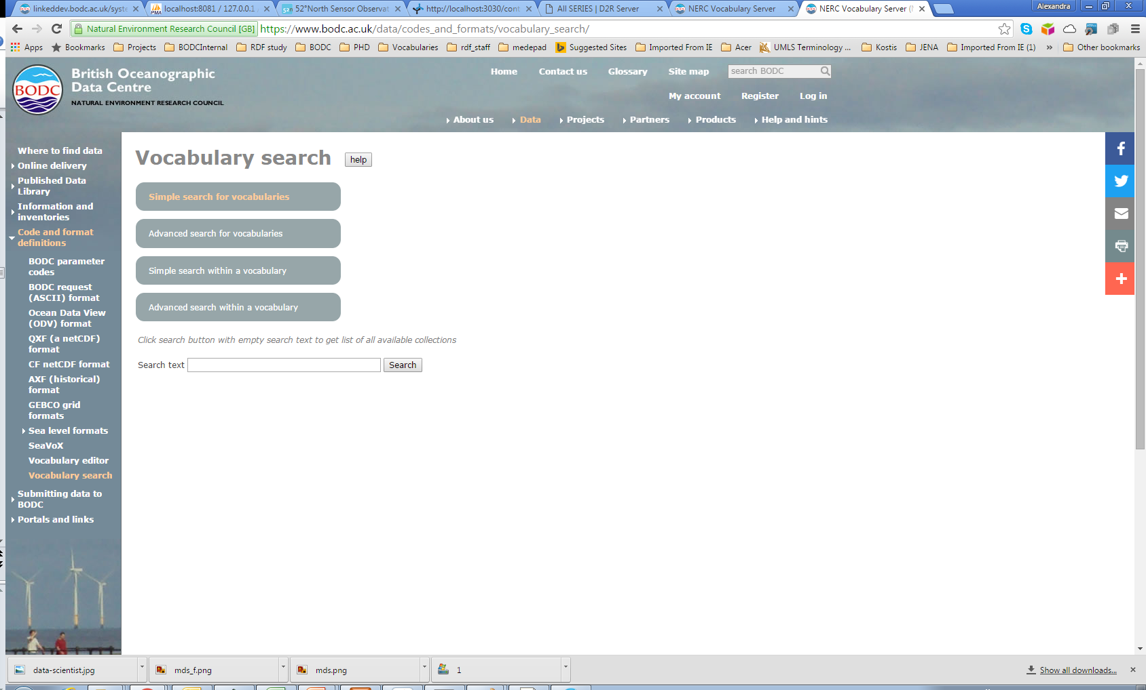

Slide 24

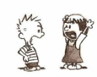
SeaDataNet NVS2 services
Existing
  SeaDataNet Vocabularies
  NVS2 Search
  SPARQL endpoint
  NVS2 editor
New
  Vocabulary builder (ex One Armed Bandit)
  NVS2 Search new functionality (Search directly in a specific vocabulary)
    Working towards ICES Synchronization (Roy is working on extending the metadata of existing concepts, consistency check with WOD)
    The mapping between P07 and MMI ORR cf_standard names
    SKOS overlay with OWL (under discussions)
    Add more predicates

Slide 25
SensorML Candidate vocabularies
SensorML specific vocabularies
  W01 - SeaDataNet Sensor Web Enablement and SensorML type vocabulary
  W02 - SeaDataNet Sensor Web Enablement and SensorML sub-type vocabulary
  GS1 - Geo-Seas features of interest
  GS2 - Geo-Seas observed property
  Feature of Interest
    GS1, S26 - matrix (BODC governed)
  Observable Property
Fine granularity (usage metadata) - P01, P07 etc.
Coarse granularity (discovery metadata) - GS2
  Characteristics&MeasurementCapabilities(weight, height, width, Frequency, Latency, Precision etc)
  If additional new vocabularies are required then need to ascertain the content
  governance authority. NVS2 can deliver the technical governance.

Slide 26
Ongoing developments as part of the SenseOcean project

Slide 27
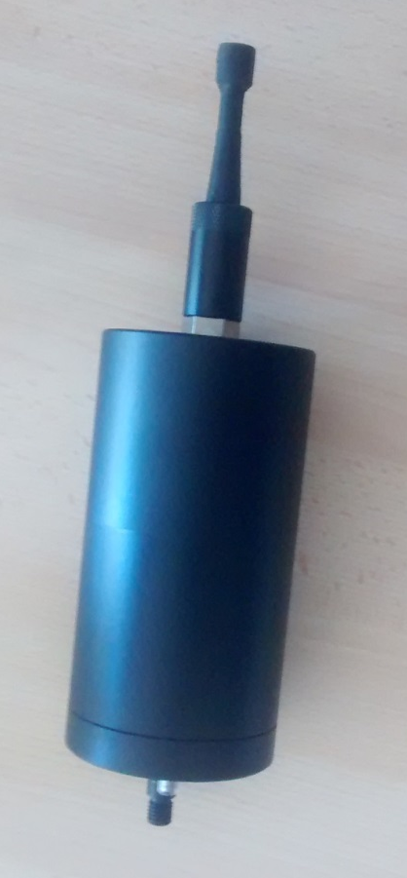
SenseOCEAN
SenseOCEAN draws together world leading marine sensor developers to create a highly integrated multifunction and cost-effective in situ marine biogeochemical sensor system.
Ensure that
  Key metadata and technical data from novel sensors are never lost
  Efficient data processing
  Efficient data archival
  Seamless data delivery
Interoperability … apply data standards from sensor through to delivery

Slide 28
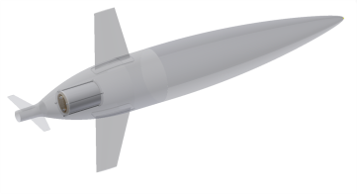
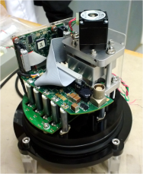
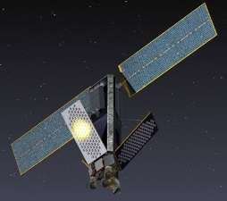
Proposed approach
Sensor passes UUID through to base station
Platform
Satellite
Base station/
Data centre
Data delivery by SOS service and linked ocean data library
NERC
Linked data
(RDF, SPARQL)
server
UUID
SensorML
SSN (OWL)
JSON LD
Reference for netCDF Link Data conventions:
Yu J. et al. Towards Linked Data Conventions for Delivery of Environmental Data Using netCDF: pages 102-112; Springer., ISBN: 978-3-319-15993-5
netCDF EGO 1.1, CF1.6, LD

Slide 29
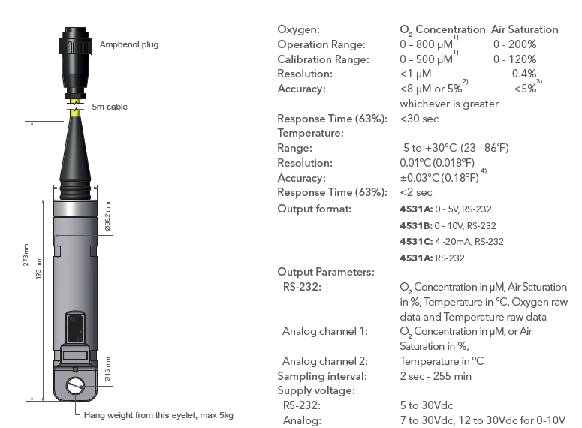
Aanderaa Oxygen Optode 4531

Slide 30
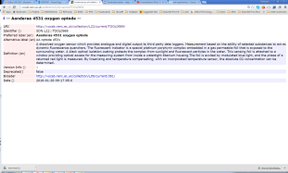
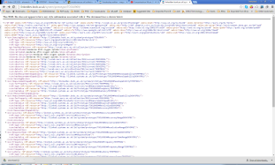
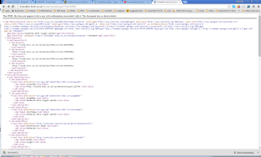
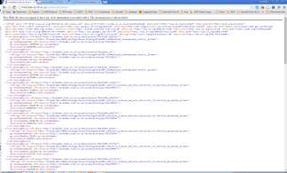
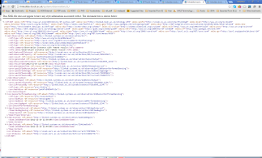
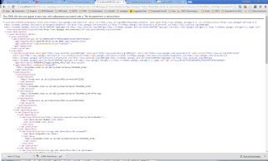
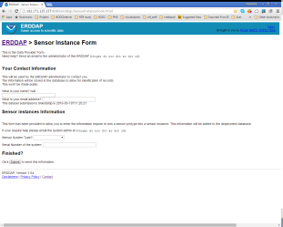
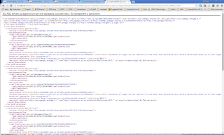
WEB
NVS2
RDF/HTML
Sensor Models
L22
SKOS
Lise
RDF
SSN
SensorML
SenseOcean
DB
RDF
SSN
52North
SOS Access Point
DescribeSensor
instance
RDF
GetObservation
Sensor Instances
observation
Access Control
ERDDAP
instance
File Store
UUID
UUID
UUID
observation
UUID

Slide 31
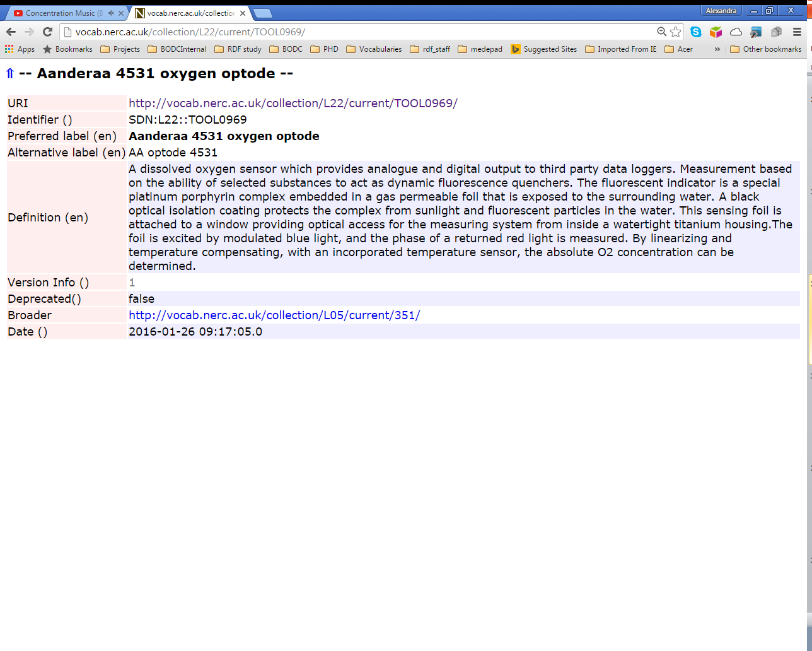

Slide 32
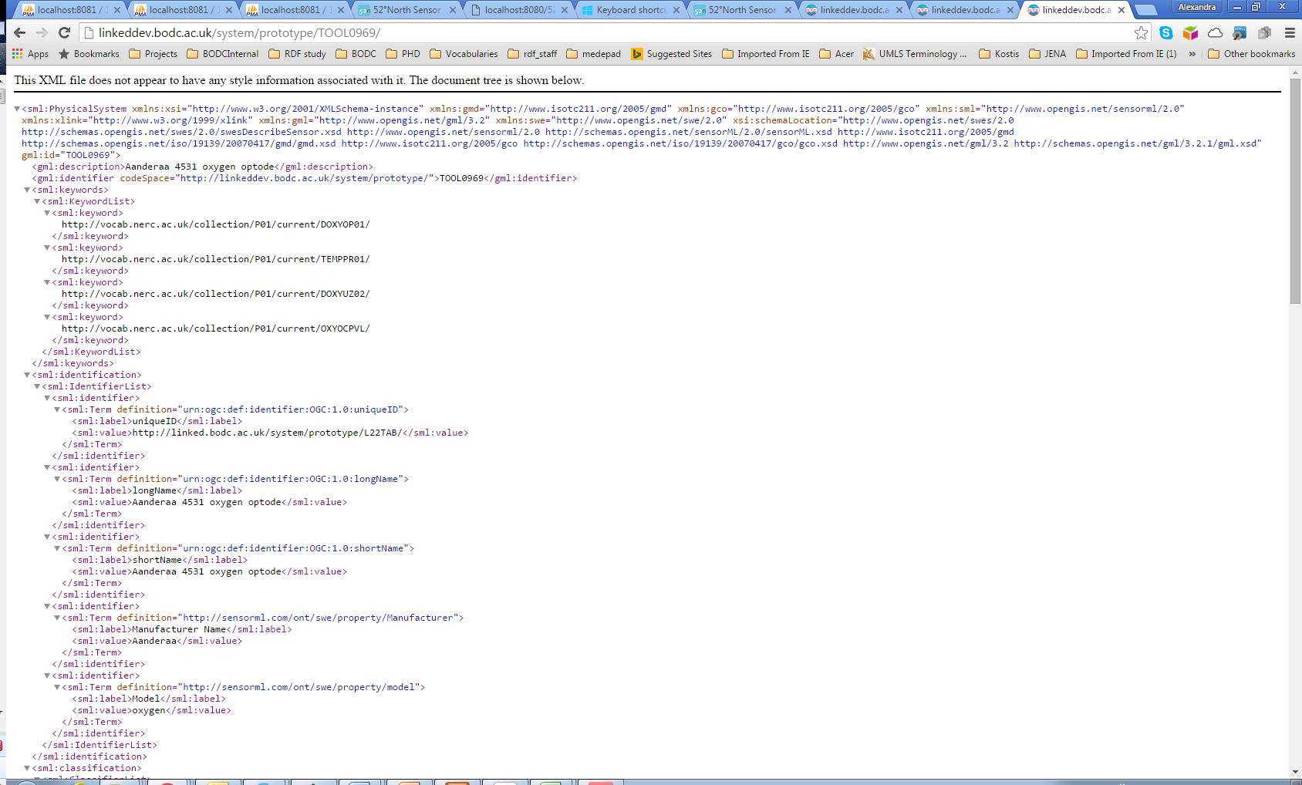
UUID→URI
Content Negotiation
Tagged with NVS2
and
sensorML ontology
concepts

Slide 33
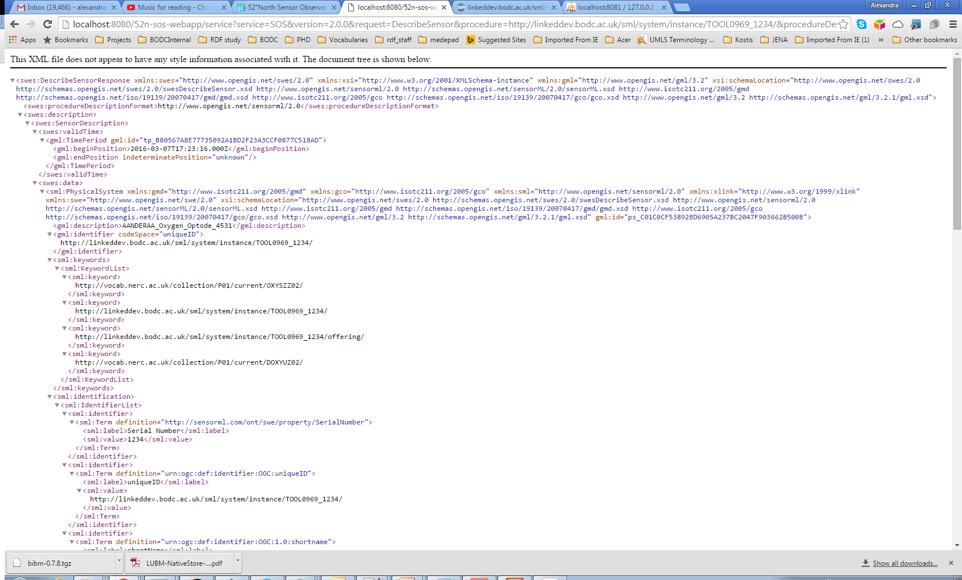

Slide 34
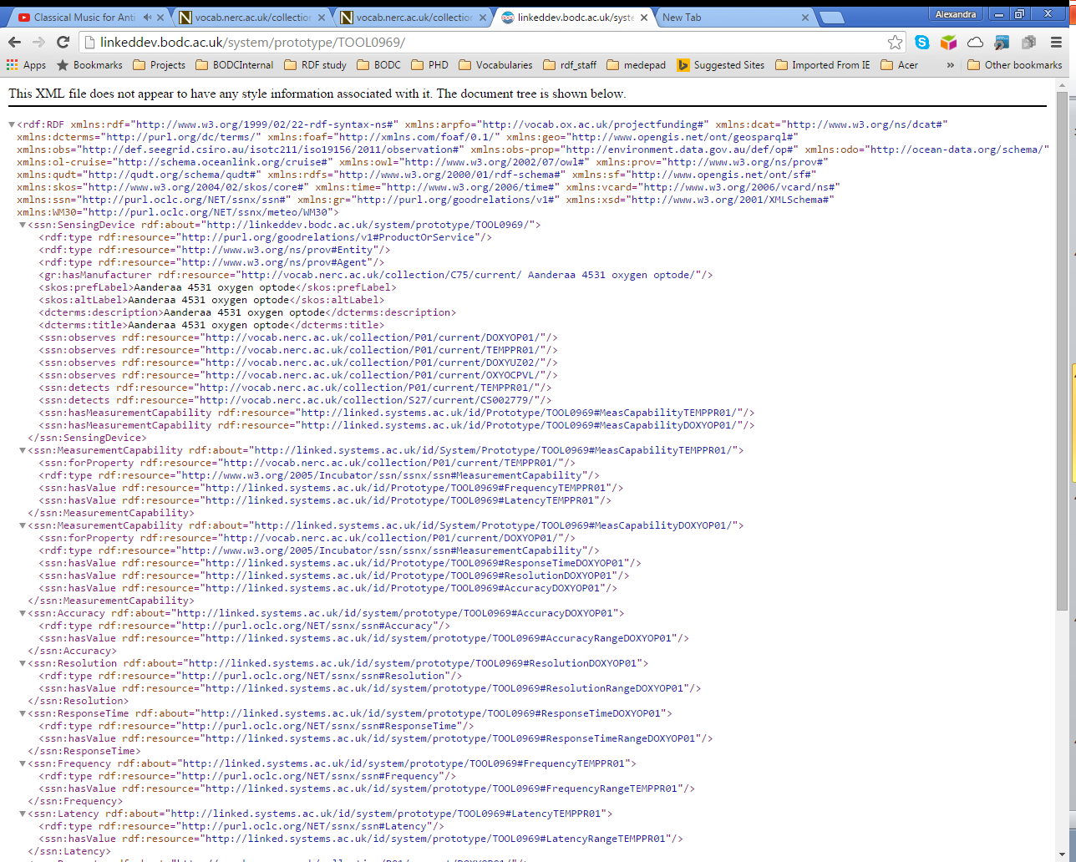
Semantic Sensor
Network Ontology
Good relations
Provenance ontology

Slide 35
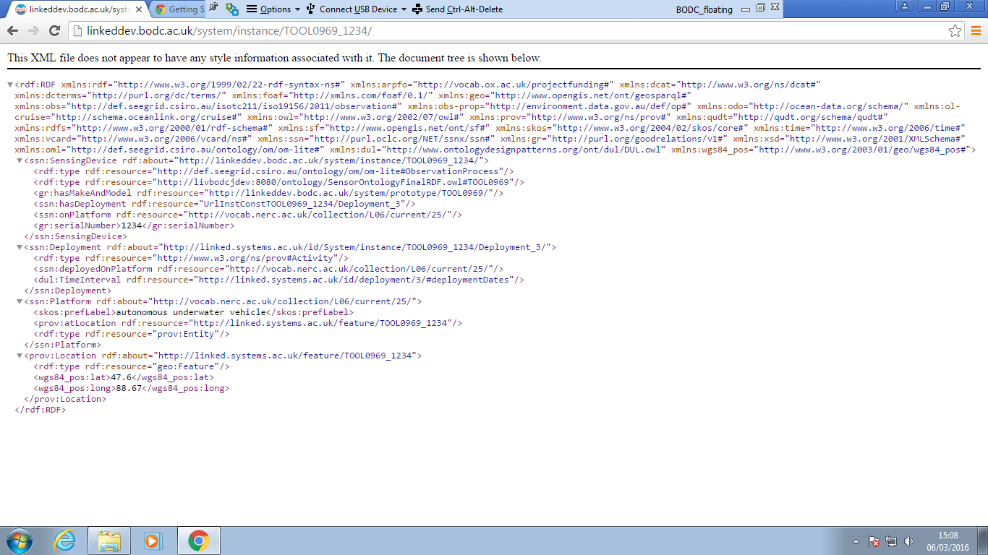

Slide 36

Add a getObservation call

Slide 37

om-lite
provo
ssn

Slide 38
RDF

Slide 39
RDF modeling
Ontologies
SSN
Good relations
Provo
om-lite
Vocabularies
NVS2
P35 (SenseOcean manufacturers)
L22 (SeaVoX Device Catalogue)
P01(observable property)
L05, L06

Slide 40
Uniform Resource Identifier
An example URI:
Describing a system prototype
UniqueIdentifier from L22
Host
http://linked.systems.ac.uk/system/prototype/TOOL0969/
http://linked.systems.ac.uk/system/instance/TOOL0969_XX3456/
Describing a system instance
Host
A Unique identifier for the concept or data
A Unique reference for the concept
Computer readable
Looks familiar

Slide 41
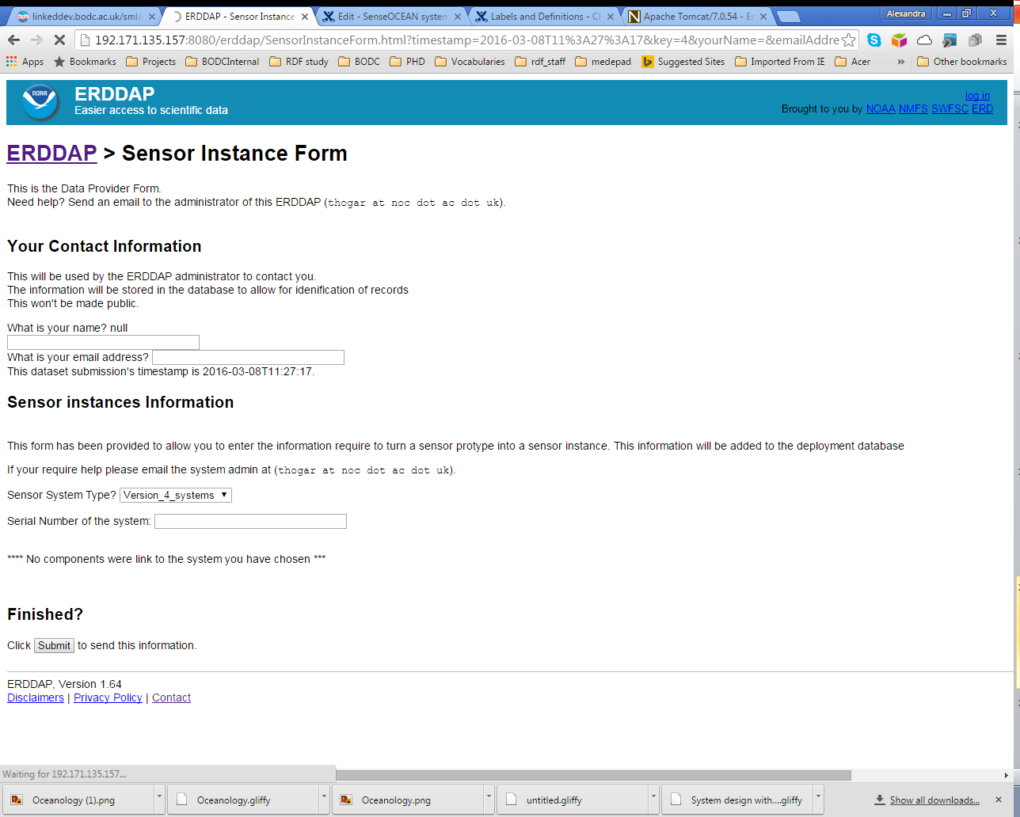

Slide 42
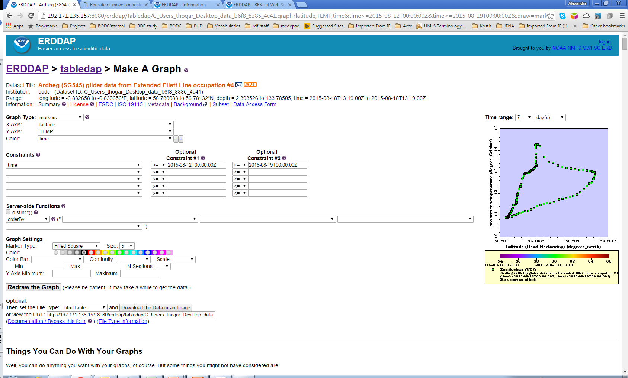

Slide 43
Conclusions
-Controlled vocabularies for
Consistency
Discoverability
Machine & human readability
-Use of standards (RDF, SensorML, SPARQL) for sensors
-Participate in communities to create agreements
-Share knowledge and best practices

Slide 44


