Slide 1


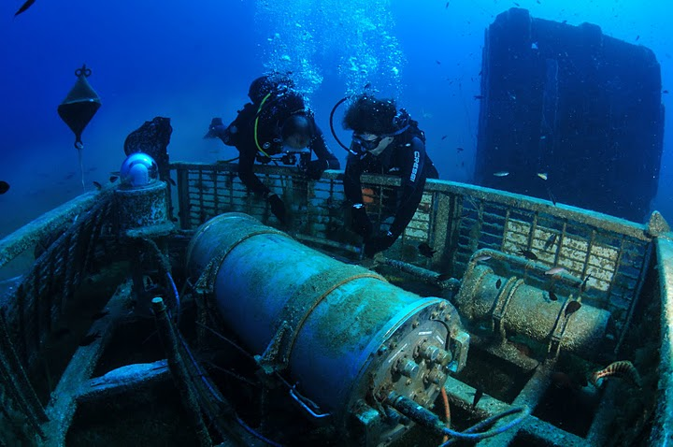
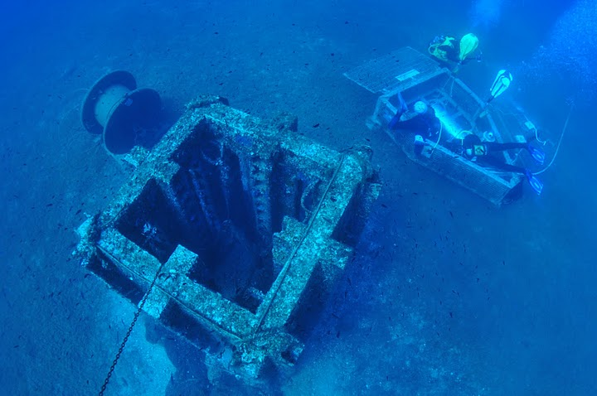
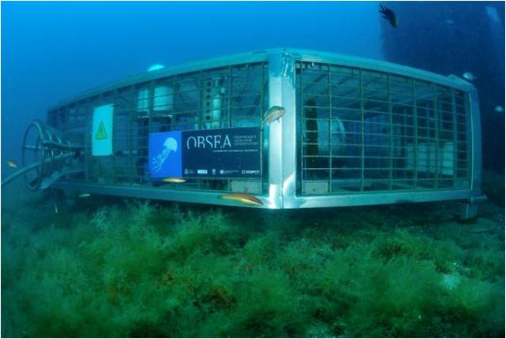
From sensors to users:
applying The OGC-Sensor Web Enablement framework
to marine observing systems
Dr. Joaquin del Rio, Simon Jirka (52N), Dr. Daniel Mihai Toma, Enoc Martinez
Notes:
Marine observing systems are composed of a huge diversity of sensors and observation platforms.
The data flow from the sensor to the user requires the use of standards protocols to minimize the effort for new sensor integration on platforms, and to improve discovery and visualization of data from the scientific community. During this webinar, the use of OGC standards applied to marine observing platforms will be shown. Examples of these standards include OGC PUCK, SensorML and the Sensor Observation Service.

Slide 2
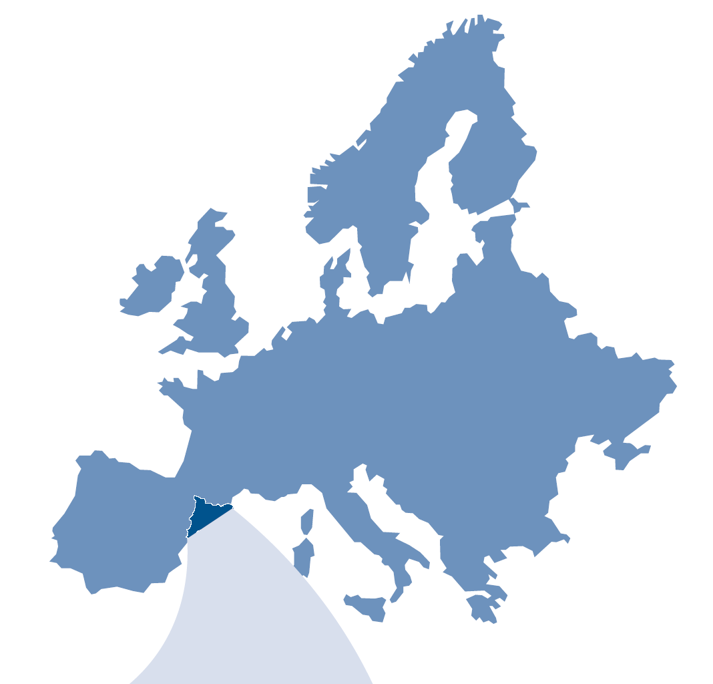
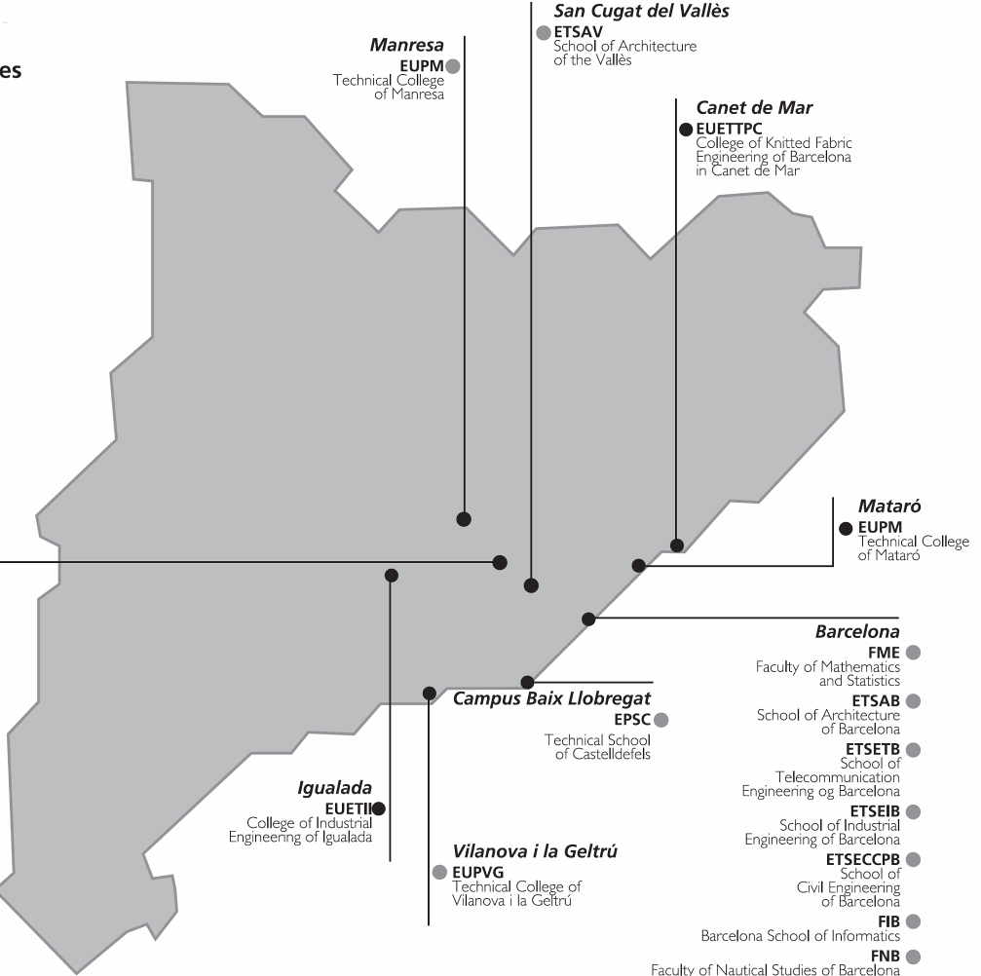
2
The Technical University of Catalonia (UPC)
Localization: Barcelona – Spain
Schools: 23
Departments: 40
Campus: 7
Students: 40000
Lectures & researcher: 2642
Research Institutes: 3
Notes:
Here we can see some examples of transversal thematic areas and its integration in all the working areas of the university.

Slide 3
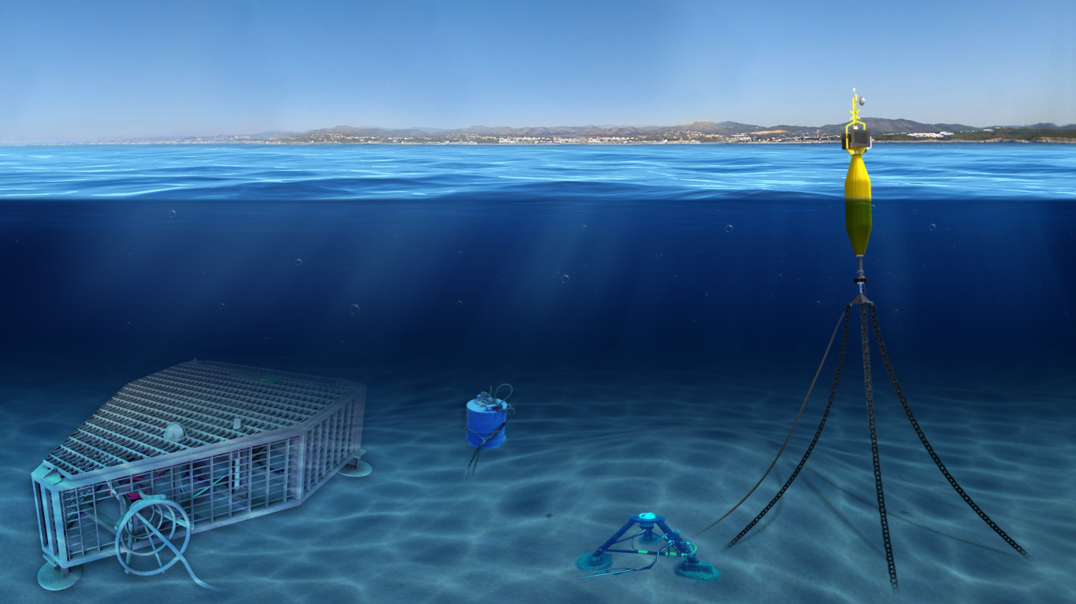
OBSEA: Shallow water cabled Observatory Test Site
www.obsea.es

Slide 4





















NeXOS
Ocean of Tomorrow Project
Project number : 614102 (FP7-OCEAN-2013.2)
Starting date : 1st of October 2013 (48 months)
21 partners from 6 European countries
Coordinator : Eric Delory (PLOCAN, Spain)
EU Project Officer: Anna-Natasa ASIK

Slide 5
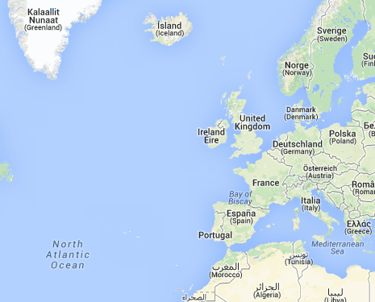
CMR
REC
NIVA
FRANATECH
Uni RESEARCH
NeXOS partners
& Host platform providers
ECORYS
Uni-HB
52N
UNOL
TrIOS
HZG
Netherlands
IFREMER, AMU
ACSA, NKE, IEEE
SMID
CNR-ISMAR
UPC
CTN
PLOCAN
(Coord.)

Slide 6
NeXOS rationale and objectives
Deliver the new sensors (WP3 to 7): acoustic, optical, fisheries.
Engage with users, developers, operators, and the public to establish requirements, incl. through scenarios (WP1)
Study market status and needs (WP2)
Make data more accessible and interoperable (WP4 and 9)
Make sensors smarter (e.g. searchable, standard interfacing, standard data) (WP4)
Increase sensor reliability (WP1, WP3)
Validate and demonstrate in the field (WP8 and 9)

Slide 7

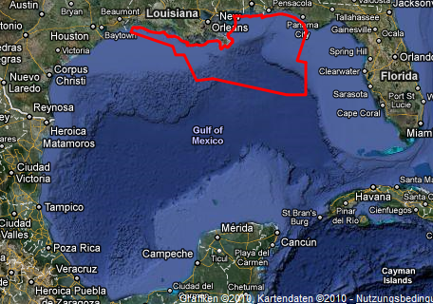


We have an objective: To facilitate the integration of new sensors
on different platforms, and make the data available as soon as possible
Notes:
Uno de los objetivos finales debe ser la posibilidad de realizar la instalación de nuevos equipos de medida, ya sea en observatorios actuales, en observatorios de nuevo diseño, o en zonas de emergencia debido a catástrofes, y que los datos generados por estos pueden llegar a los usuarios los más rápidamente posible sin la necesidad de realizar esfuerzos de instalación y configuracion.

Slide 8
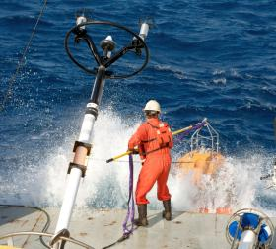
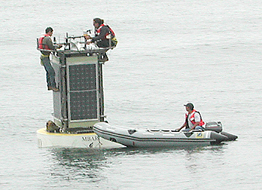
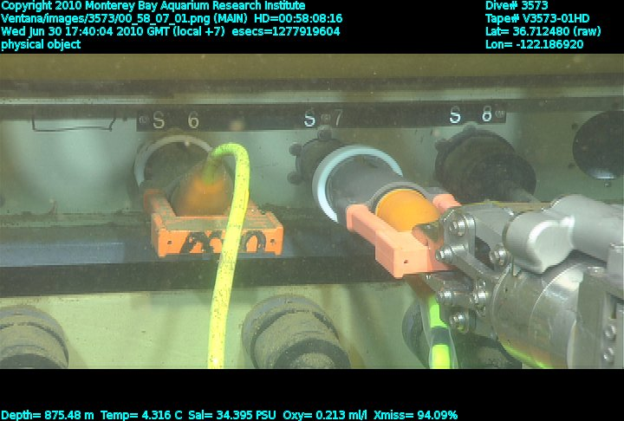
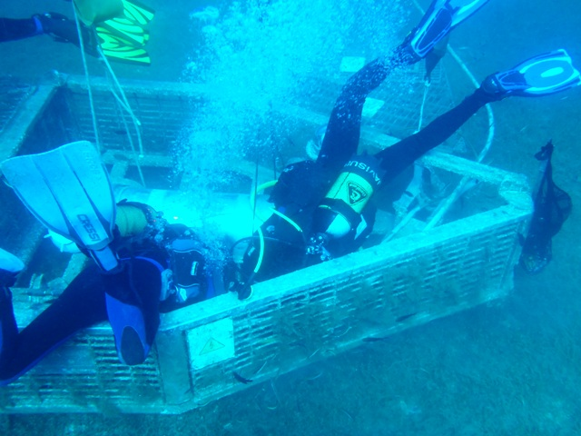
Integration of new sensors on existing operational platforms could be a great challenge
Monterrey Bay Aquarium Research Institute, www.mbari.org
Observatorio OBSEA, www.obsea.es
Notes:
En el mar, tanto en observatorios de superficie (boyas) o submarinos, el procedimiento de contectar o desconectar un instrumento puede devenir muy complejo y se debe evitar cualquier proceso de configuración manual. La instalacion plug’and’play de un instrumento en un observatorio es uno de los objetivos buscados.

Slide 9


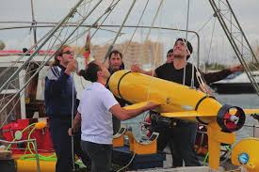
End to End…

Slide 10
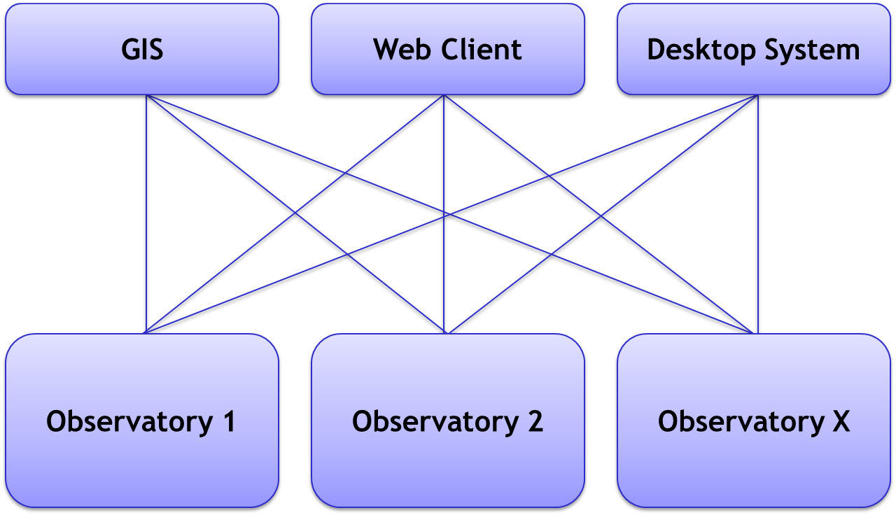
Sensor Web
Without standardisation:
Individual coupling of each data source to each consumer → very high integration efforts needed

Slide 11
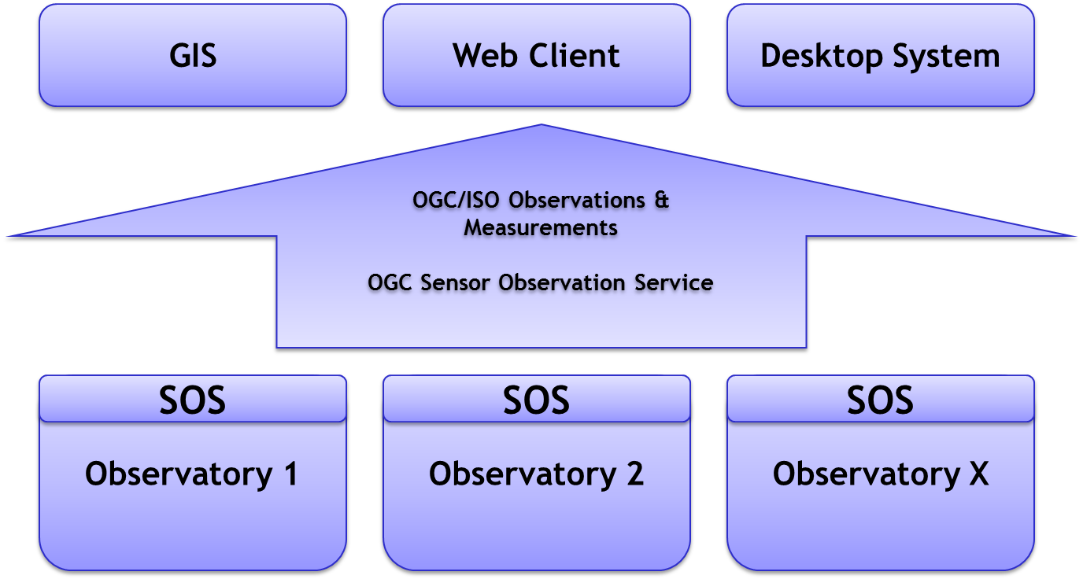
Sensor Web
With standardisation:
Standards need to be implemented only once for each source and consumer → less integration efforts needed

Slide 12

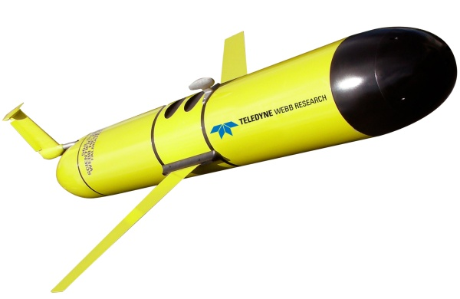
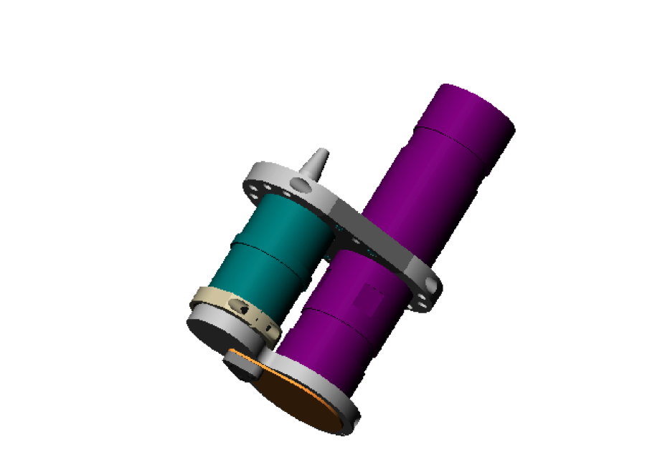
Two different levels:
Instrument side and Client side
Client Side
Instrument Side

Slide 13
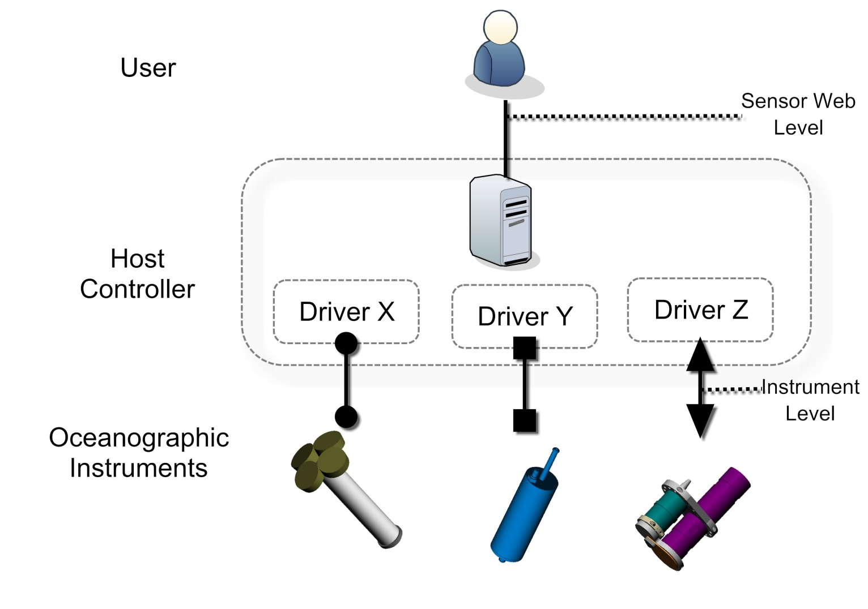
How it works habitually at the instrument side?
Driver oriented communication

Slide 14
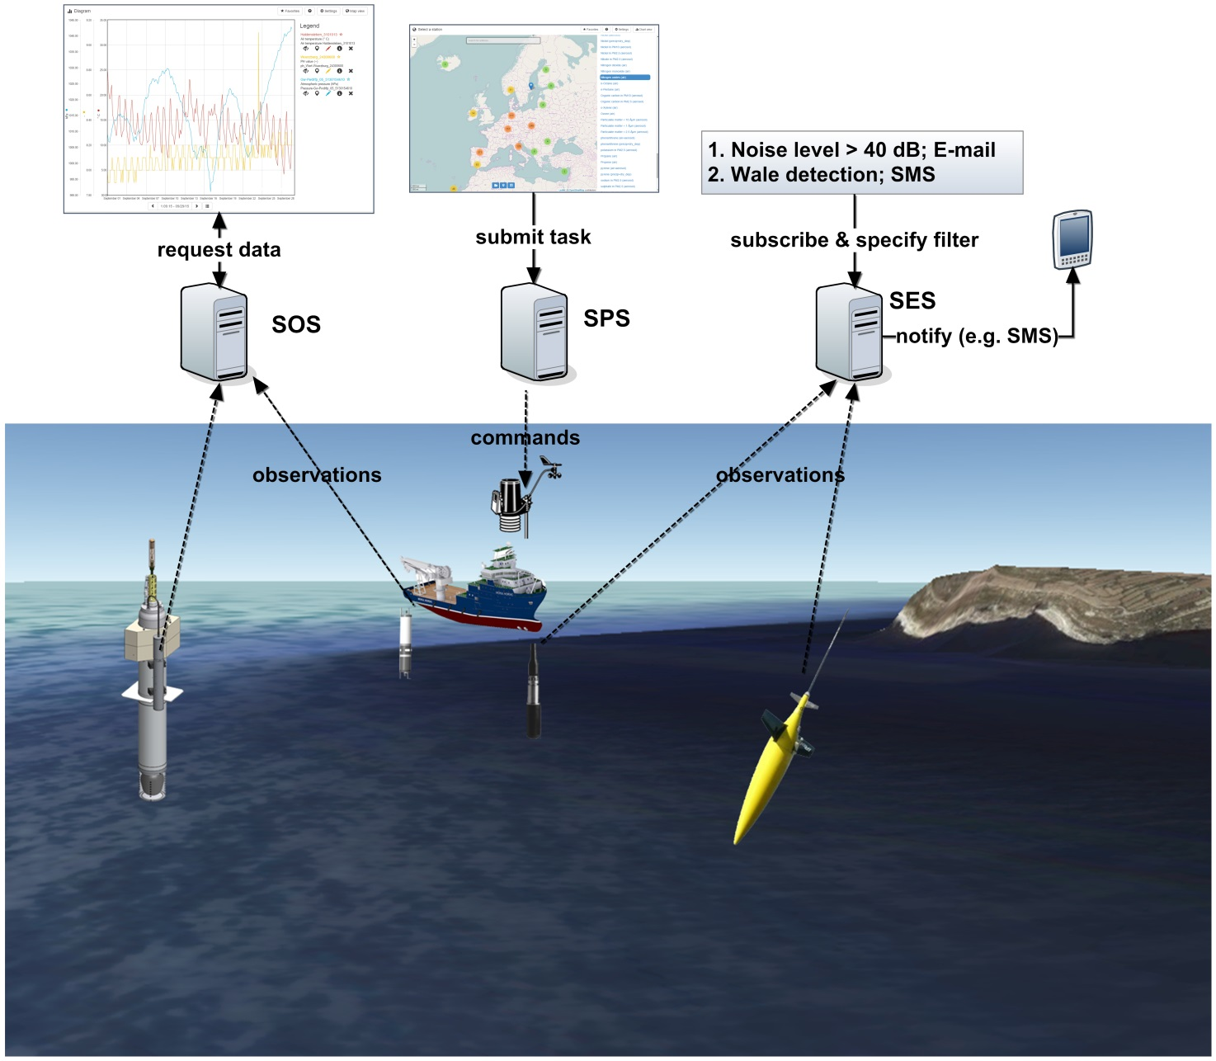

At the client side, SWE Architecture seems to cover some necessities
Machine to Machine well defined process
Discover Data
Visualize Data
Real time & archive

Slide 15
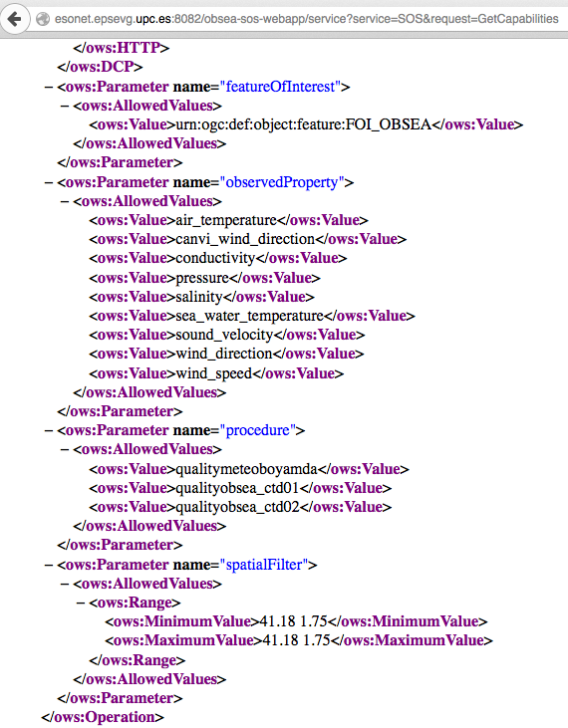
The OGC Sensor Observation Service aggregates readings from live, in-situ and remote sensors. The service provides an interface to make sensors and sensor data archives accessible via an interoperable web based interface.
http://esonet.epsevg.upc.es:8082/obsea-sos-webapp/service?service=SOS&request=GetCapabilities

Slide 16
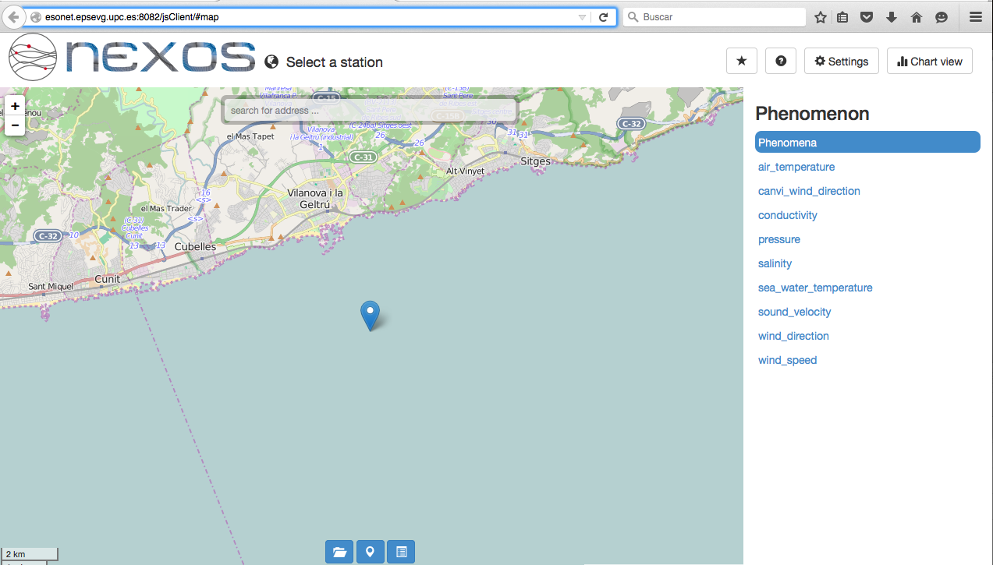

SOS Client accessing Obsea SOS Server
Link to the Map client: http://esonet.epsevg.upc.es:8082/jsClient/#map

Slide 17
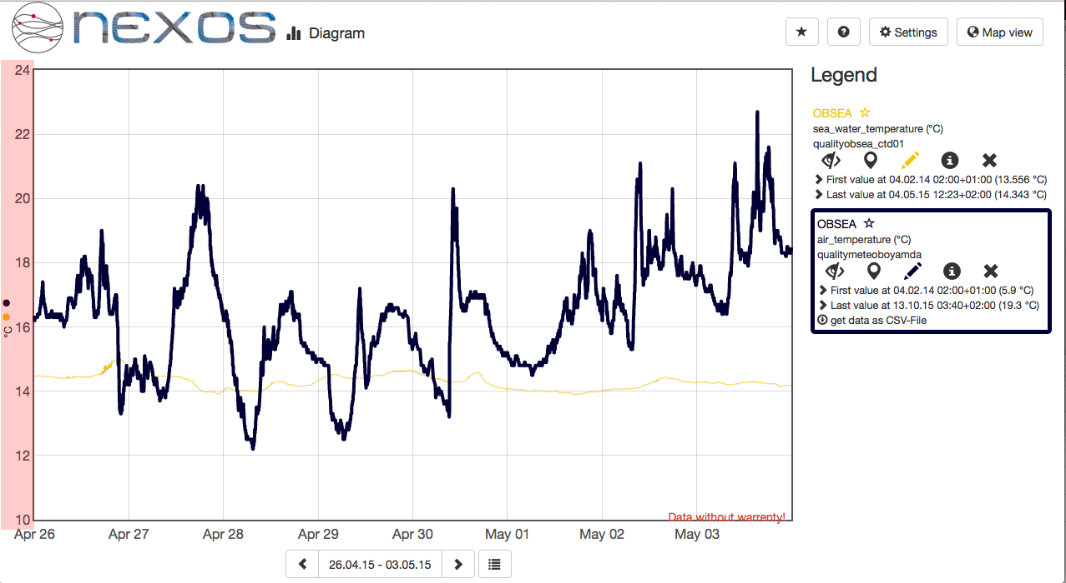
SOS Client accessing Obsea SOS Server
Link to the Map client: http://esonet.epsevg.upc.es:8082/jsClient/#map

Slide 18
How it works habitually at the instrument side?
Driver oriented communication

Slide 19
Propietary commands hinder the “standarization process”: Physical Layer mainly RS232-485
Response to "$run" command: Delimiter: space
08/04/11 14:44:28 4996 13896 17333 08/04/11 14:44:28 16777 13896 17333 08/04/11 14:44:29 16777 13896 17333
tokens: date (mm/dd/yy), time (hh:mm:ss), chlorophyll (counts), backscatter1 (counts), backscatter2 (counts)
Example response of WET Labs Triplet
Response to "C" command: Delimiter: comma.
2355,1904,1601,2472,1471,1860,1686,2950,1754,1663,1653,2472,1471,0,0,0,0,0,0,0,0,0,0,0,0,0,0,0,0,0,0,0,0,1,0,0,0,0,0,0,0,5,5,5,3,3,3,3,3,177,2677,0,128,116<CR><LF>
tokens: Time elapsed since, signal1, sigOffset1, reference1, refOffset1, signal2, sigOffset2, reference2, refOffset2,... <unused channels> ... <housekeeping data> ... pressure, 0, temperature, battery voltage.
Example response of HOBI Labs HydroScat-2
Response to "F00" command: Delimiter: space
TIM 000302213620 -0.0042 20.7903 10.5324 FET
tokens: "TIM" (fixed marker), YYMMDDhhmmss, conductivity (mS/cm), temperature (deg C), pressure (decibar), "FET" (fixed marker)
Example response of RBR instrument
Response to "TS" command: Delimiter: comma
20.8397, 0.00006, 0.028, 0.0103, 1484.920, 01 Jan 1980, 00:00:01<CR><LF>
tokens: temperature (deg C), conductivity (siemens/meter), pressure (decibar), salinity (psu), sound velocity (meter/sec), dd mmm yyyy,: hh:mm:ss
Example response of SBE-37SM instrument
Notes:
A modo de ejemplo, mostramos aquí los protocolos de cuatro instrumentos comunmente utilizados en observatorios, de cuatro fabricantes diferentes. Pede observarse la variedad en comandos y formatos utilizados. En este ejemplo sólo se han mostrado instrumentos que utilizan ASCII para la comunicación. También existe que utilizan codificación binaria.
Debido a la variedad de protocolos, no existe un procedimiento estándar de detección, identificación y configuración del instrumento.

Slide 20
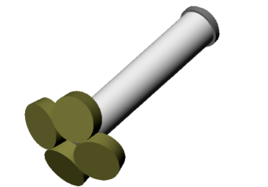
“ts”
“sample”
“Oct-22-2008 14:21:09 32.3 -.02 9.1”
abcd efghij kl
Brand X
Brand Y
Courtesy of Tom O’Reilly from MBARI
Notes:
Today’s oceanographic instrument market is characterized by very diverse instrument command protocols, very few standards
A single user can be an expert in a few protocols, but problem gets really bad for 10s or 100s of different protocols!

Slide 21
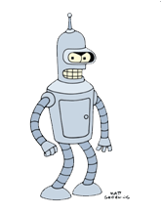

abcd efghij kl
“getData”
+ parsing instructions
“Oct-22-2008 32.3 -.02 9.1”
“getData”
+ parsing instructions
Std. Interface
Std. Inteface
Driver
Brand X
Driver will translate from propietary protocol, to and standard protocol
Pros: Any instrument can be integrated if the driver exists.
Const:If the driver doesn’t exist, a specific driver for the instrument and platform have to be developed and integrated on the platform.
Driver
Brand Y
“ts”
“sample”
abcd efghij kl
“Oct-22-2008 32.3 -.02 9.1”
Brand X
Brand Y
Question: Can there be a universal driver?
Courtesy of Tom O’Reilly from MBARI

Slide 22
Questions:
Can all the instruments have a standard interface protocol?
  Our experience say NO.
Can there be a universal driver that deal with any type instrument?
Can data from the instrument have a well known traceability about
  Where the data is being acquired
  Which instrument acquired the data?
  When?
  And all of these information can accompany the data from end to end ( from instrument to the user)

Slide 23

The proposal…
any instrument has to have an autodescriptive “file” with information about the instrument.
This “file”, preferably, will be stored inside the instrument

Slide 24
This file will contain information like an UUID, the model, manufacture, measured parameters, calibration parameters, and all that will help to facilitate traceability of the generated data.

Slide 25

In addition to that, this file will contain information about how the instrument communicates: which commands have to be used to initialize, to trigger the instrument, to power down the instrument, etc…

Slide 26
The format and encoding of this file could be any… but we propose to use SensorML standard and EXI encoding

Slide 27

SensorML 2.0
rbr xr420.xml
nexos-hyd1.xml
sensor-lab-pH.xml
nke-pCO2.xml
aanderaa-pCO2.xml

Slide 28
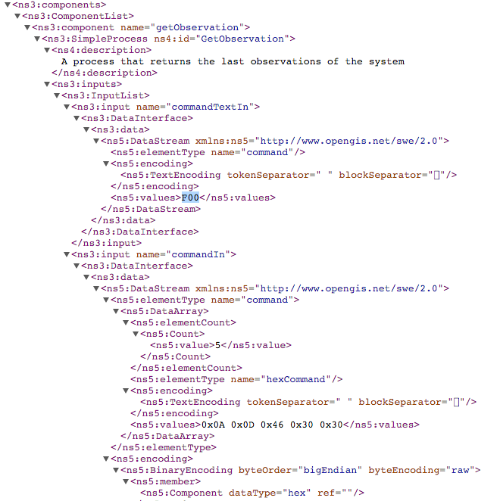
SensorML file for rbr xr420.xml

Slide 29
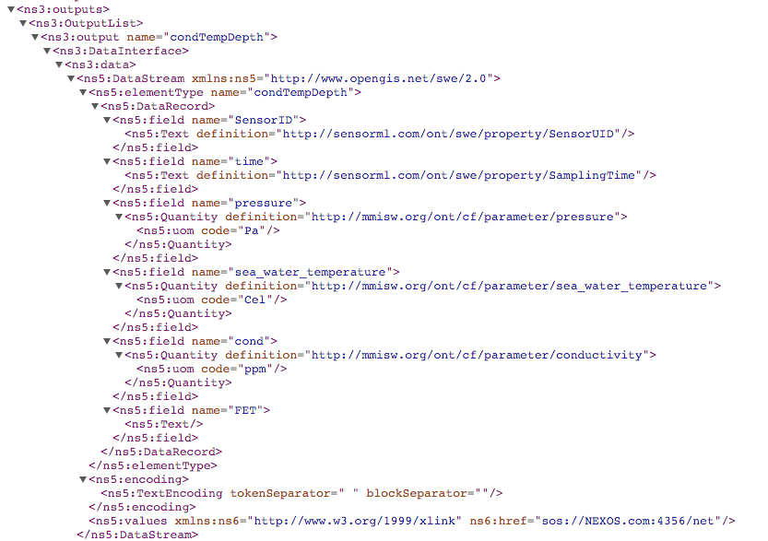
SensorML file for rbr xr420.xml

Slide 30
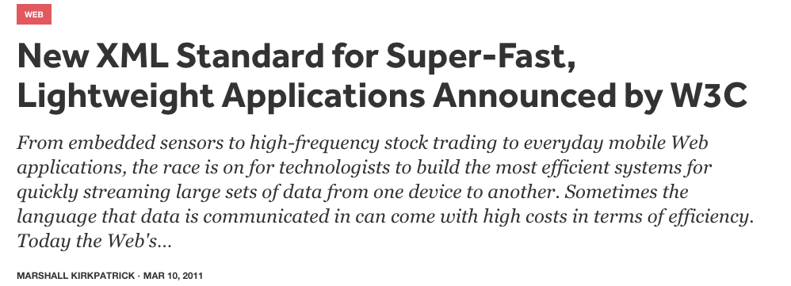
Efficient XML Interchange (EXI)
Word Wide Web Consortium (W3C) promotes EXI…

Slide 31
EXI Encoding
http://www.w3.org/TR/exi/
Purpose of EXI: Efficient XML Interchange (EXI) format
Fast XML processing
Small XML interchange documents
Limited bandwidth consumption
Enable high throughput and/or processing on small controllers

Slide 32
EXI Encoding

Slide 33
Now, we have this SensorML file with EXI encoding… how are we able to deal with?
- how to store this file inside this instrument?
- how to retreive this file from a platform controller?
- how to do it in a standard way that all instruments can implemented it?

Slide 34
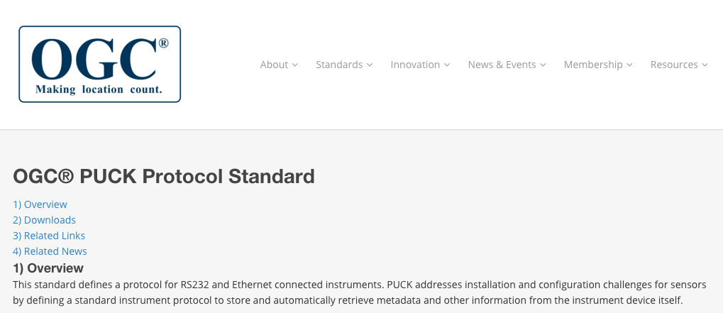
This standard defines a protocol for RS232 and Ethernet connected instruments. PUCK addresses installation and configuration challenges for sensors by defining a standard instrument protocol to store and automatically retrieve metadata and other information from the instrument device itself.

Slide 35
Instruments with a command oriented communication can “add” these commands to their propietary commands data set in order to manage the PUCK memory to write and read the SensorML file.
Command | Description
PUCKRM | Read PUCK memory
PUCKWM | Write PUCK memory
PUCKFM | Finish writing PUCK
PUCKEM | Erase PUCK memory
PUCKGA | Read the PUCK memory pointer address
PUCKIM | Change to instrument mode
PUCKSA | Write the PUCK memory pointer address

Slide 36
Now, a “universal driver” or “SWE driver” executed on the platform controller, using PUCK commands, is able to retreive the information from the instrument and execute the commands described into the SensorML file for triggering the instrument, configure, etc…
Serial or Ethernet
Platforms execute SWE driver

Slide 37
SWE Service
Serial or Ethernet
On the other hand, the platform controller can “inject” data directly into an SWE-SOS server.

Slide 38
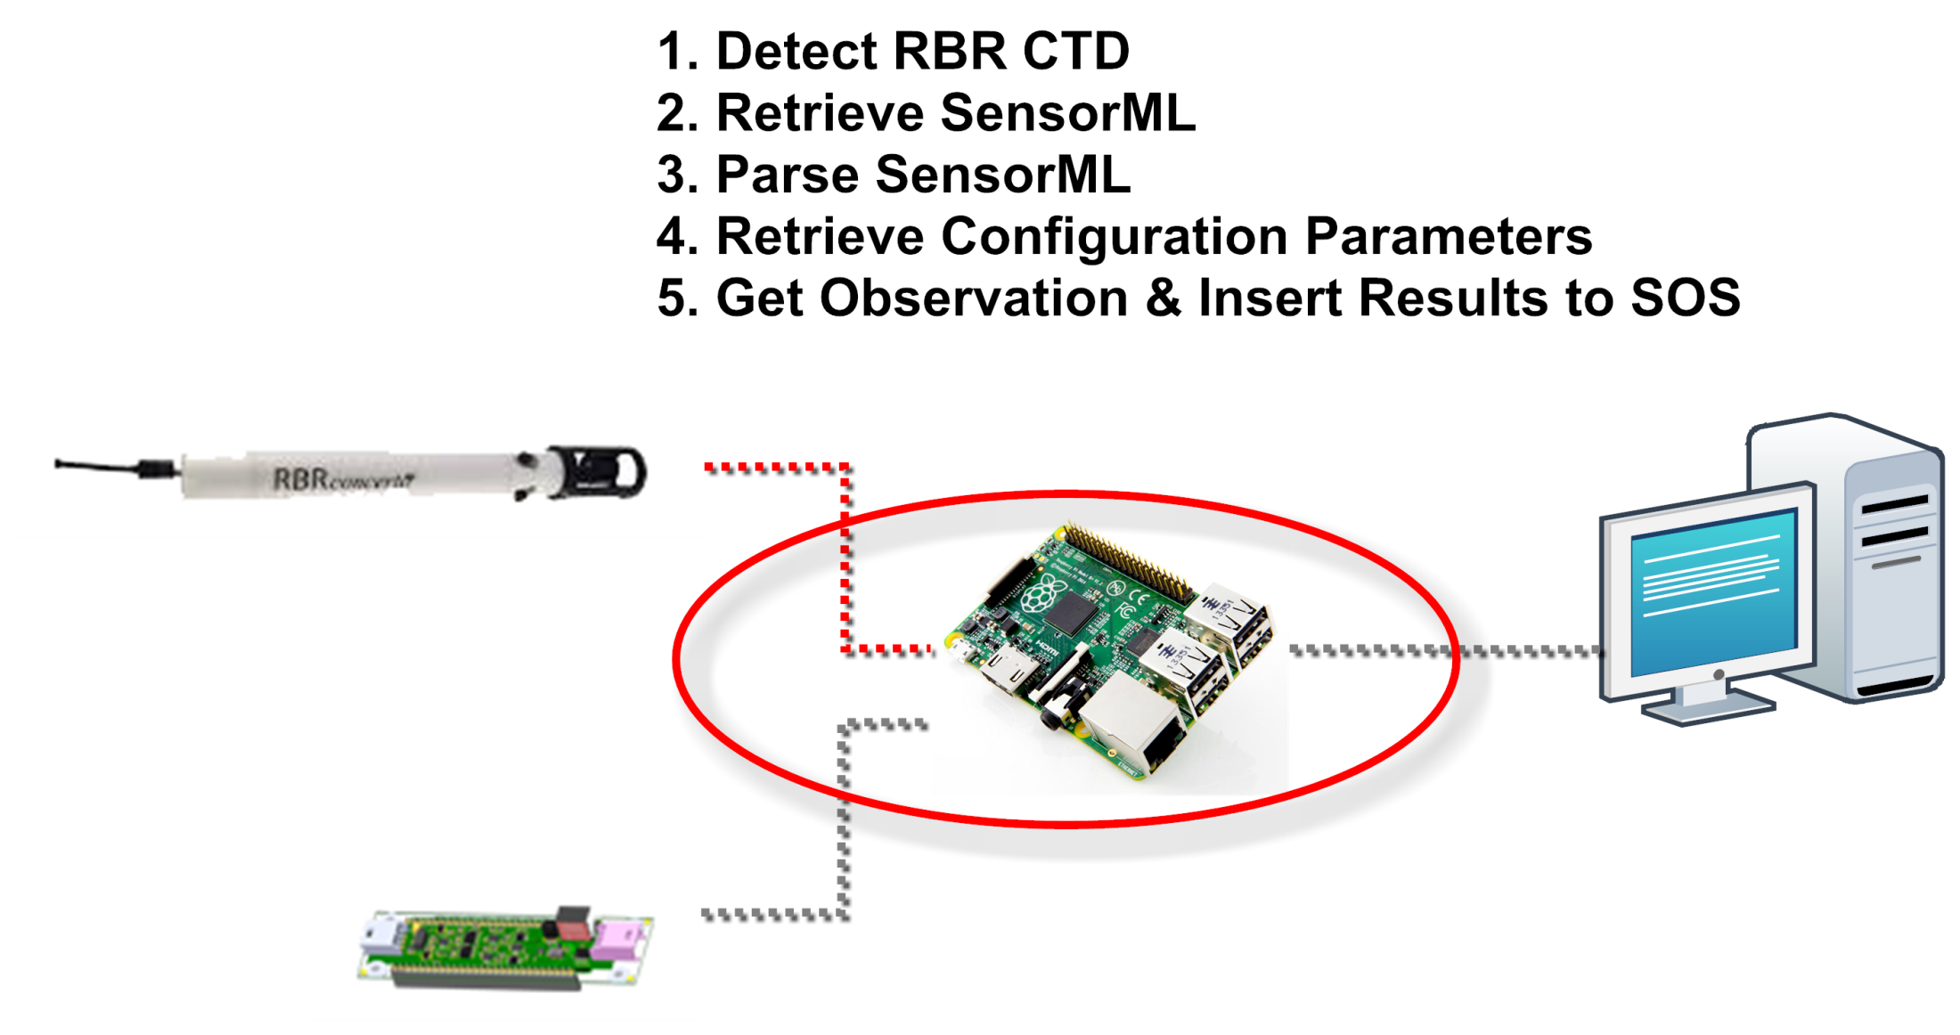

Slide 39
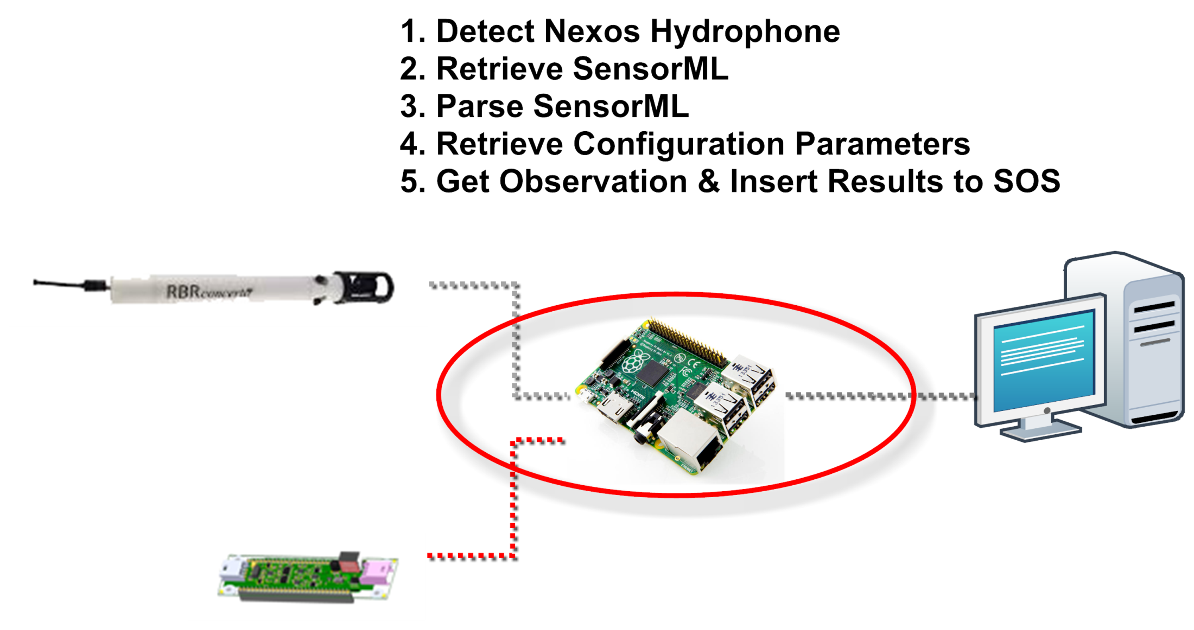

Slide 40
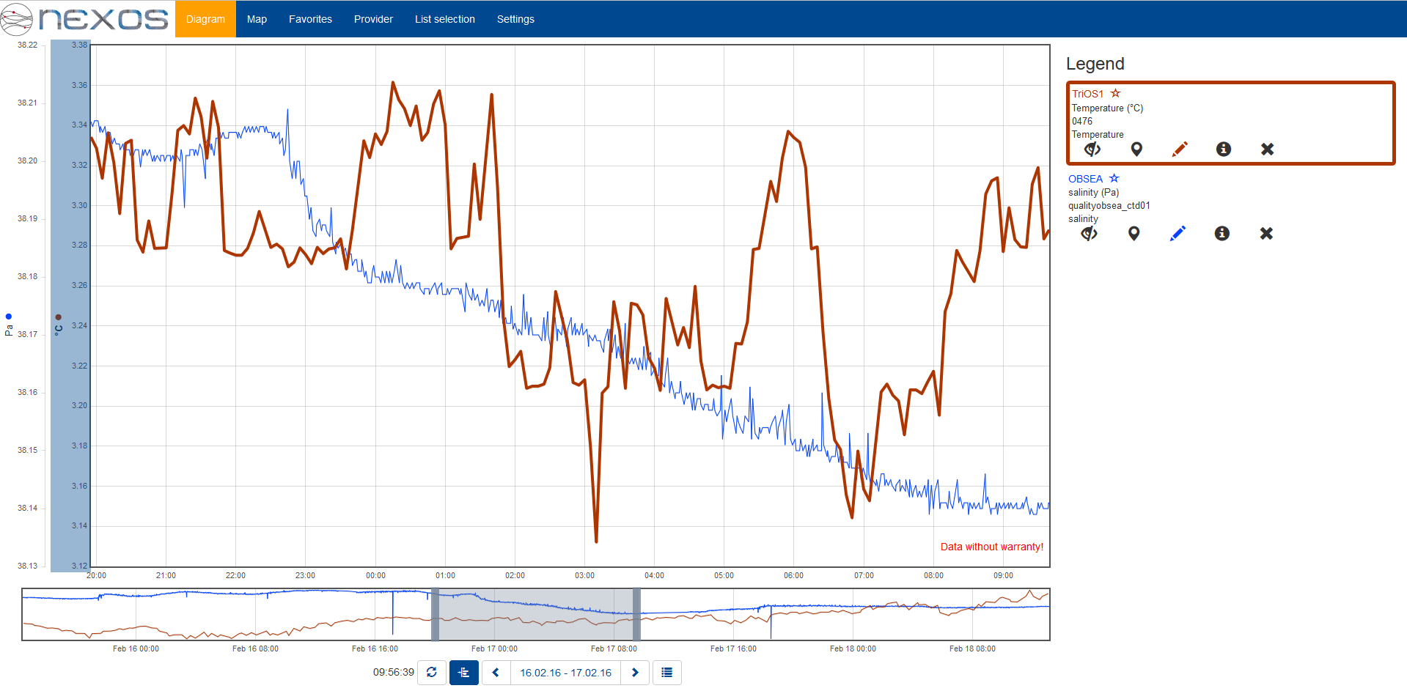
http://nexos.demo.52north.org/client/#/?timespan=2016-02-16T19%3A55%3A13%2B01%3A00%2F2016-02-17T09%3A39%3A33%2B01%3A00&ts=esonet__3%2Ctrios__ts_1153a11ce68299b439124d18a541a642

Slide 41
Demo video

Slide 42
Further Events
NeXOS Demo at the OI
EGU
  20th April 2016, Vienna (Austria)
  Session: ESSI1.1 - Informatics in Oceanography and Ocean Science
Geospatial Sensor Webs Conference 2016
  29th to 31st August 2016 (Germany)
  Call for Papers is currently open
  http://52north.org/about/other-activities/geospatial-sensor-webs-conference

Slide 43
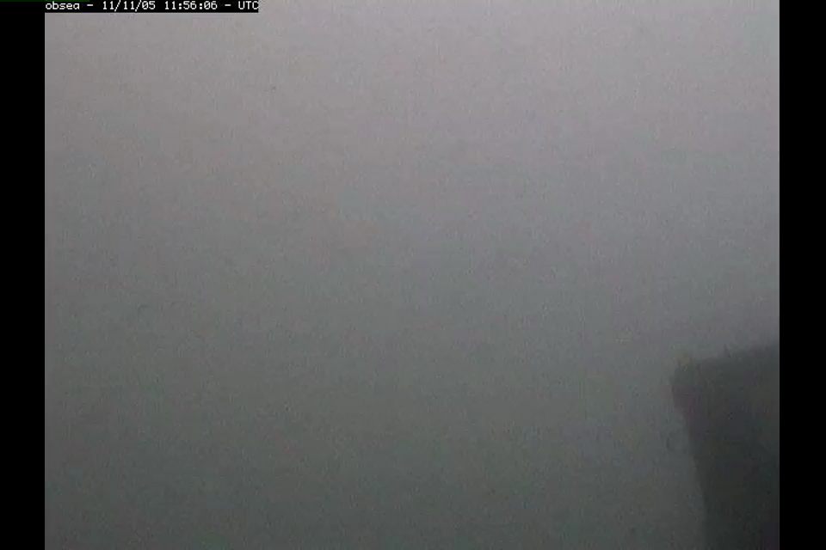

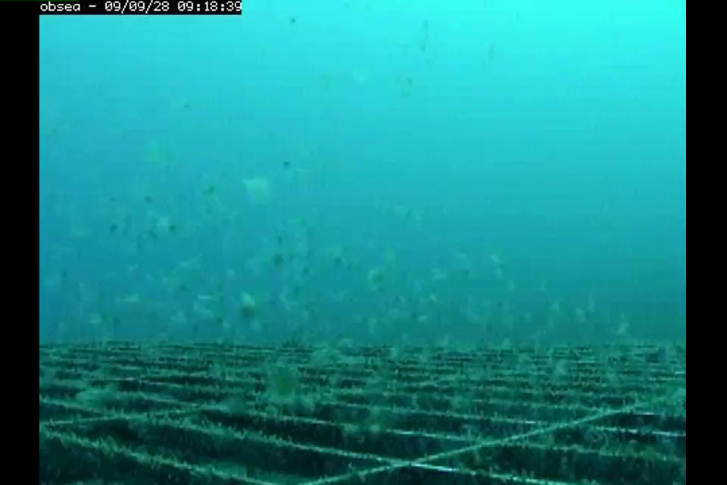
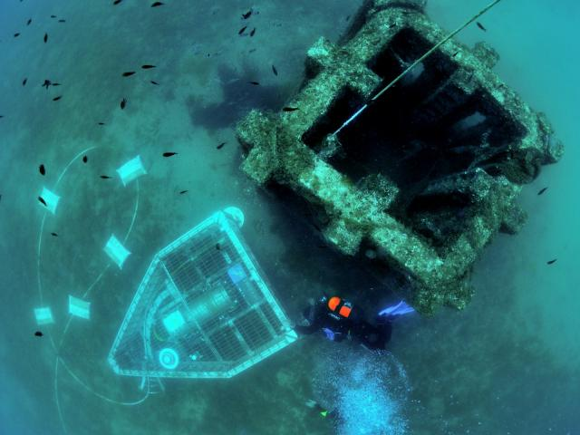
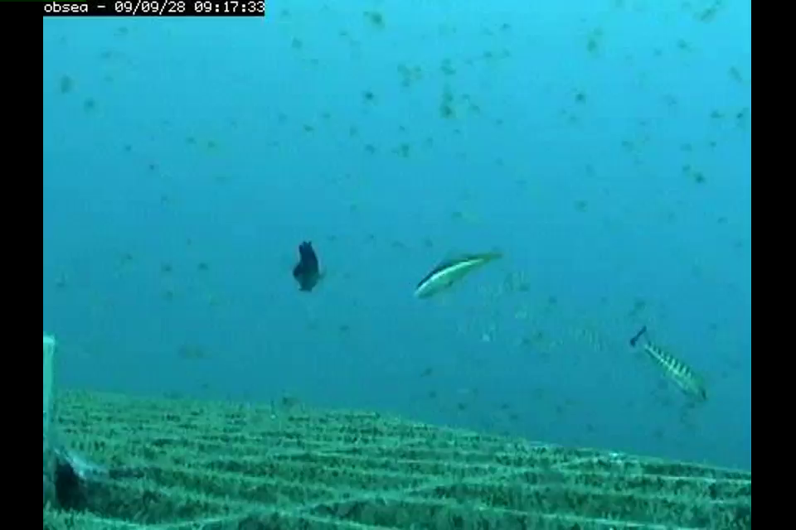
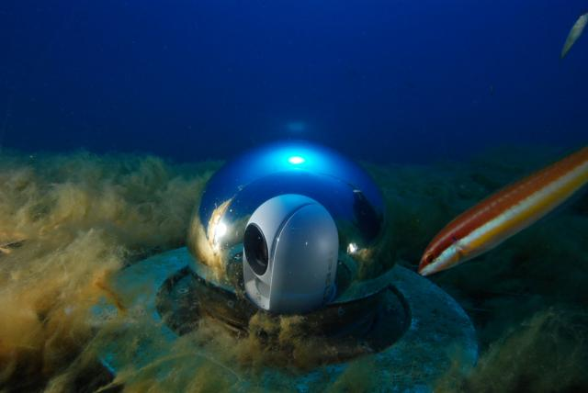
Thanks for your attention.

Slide 44
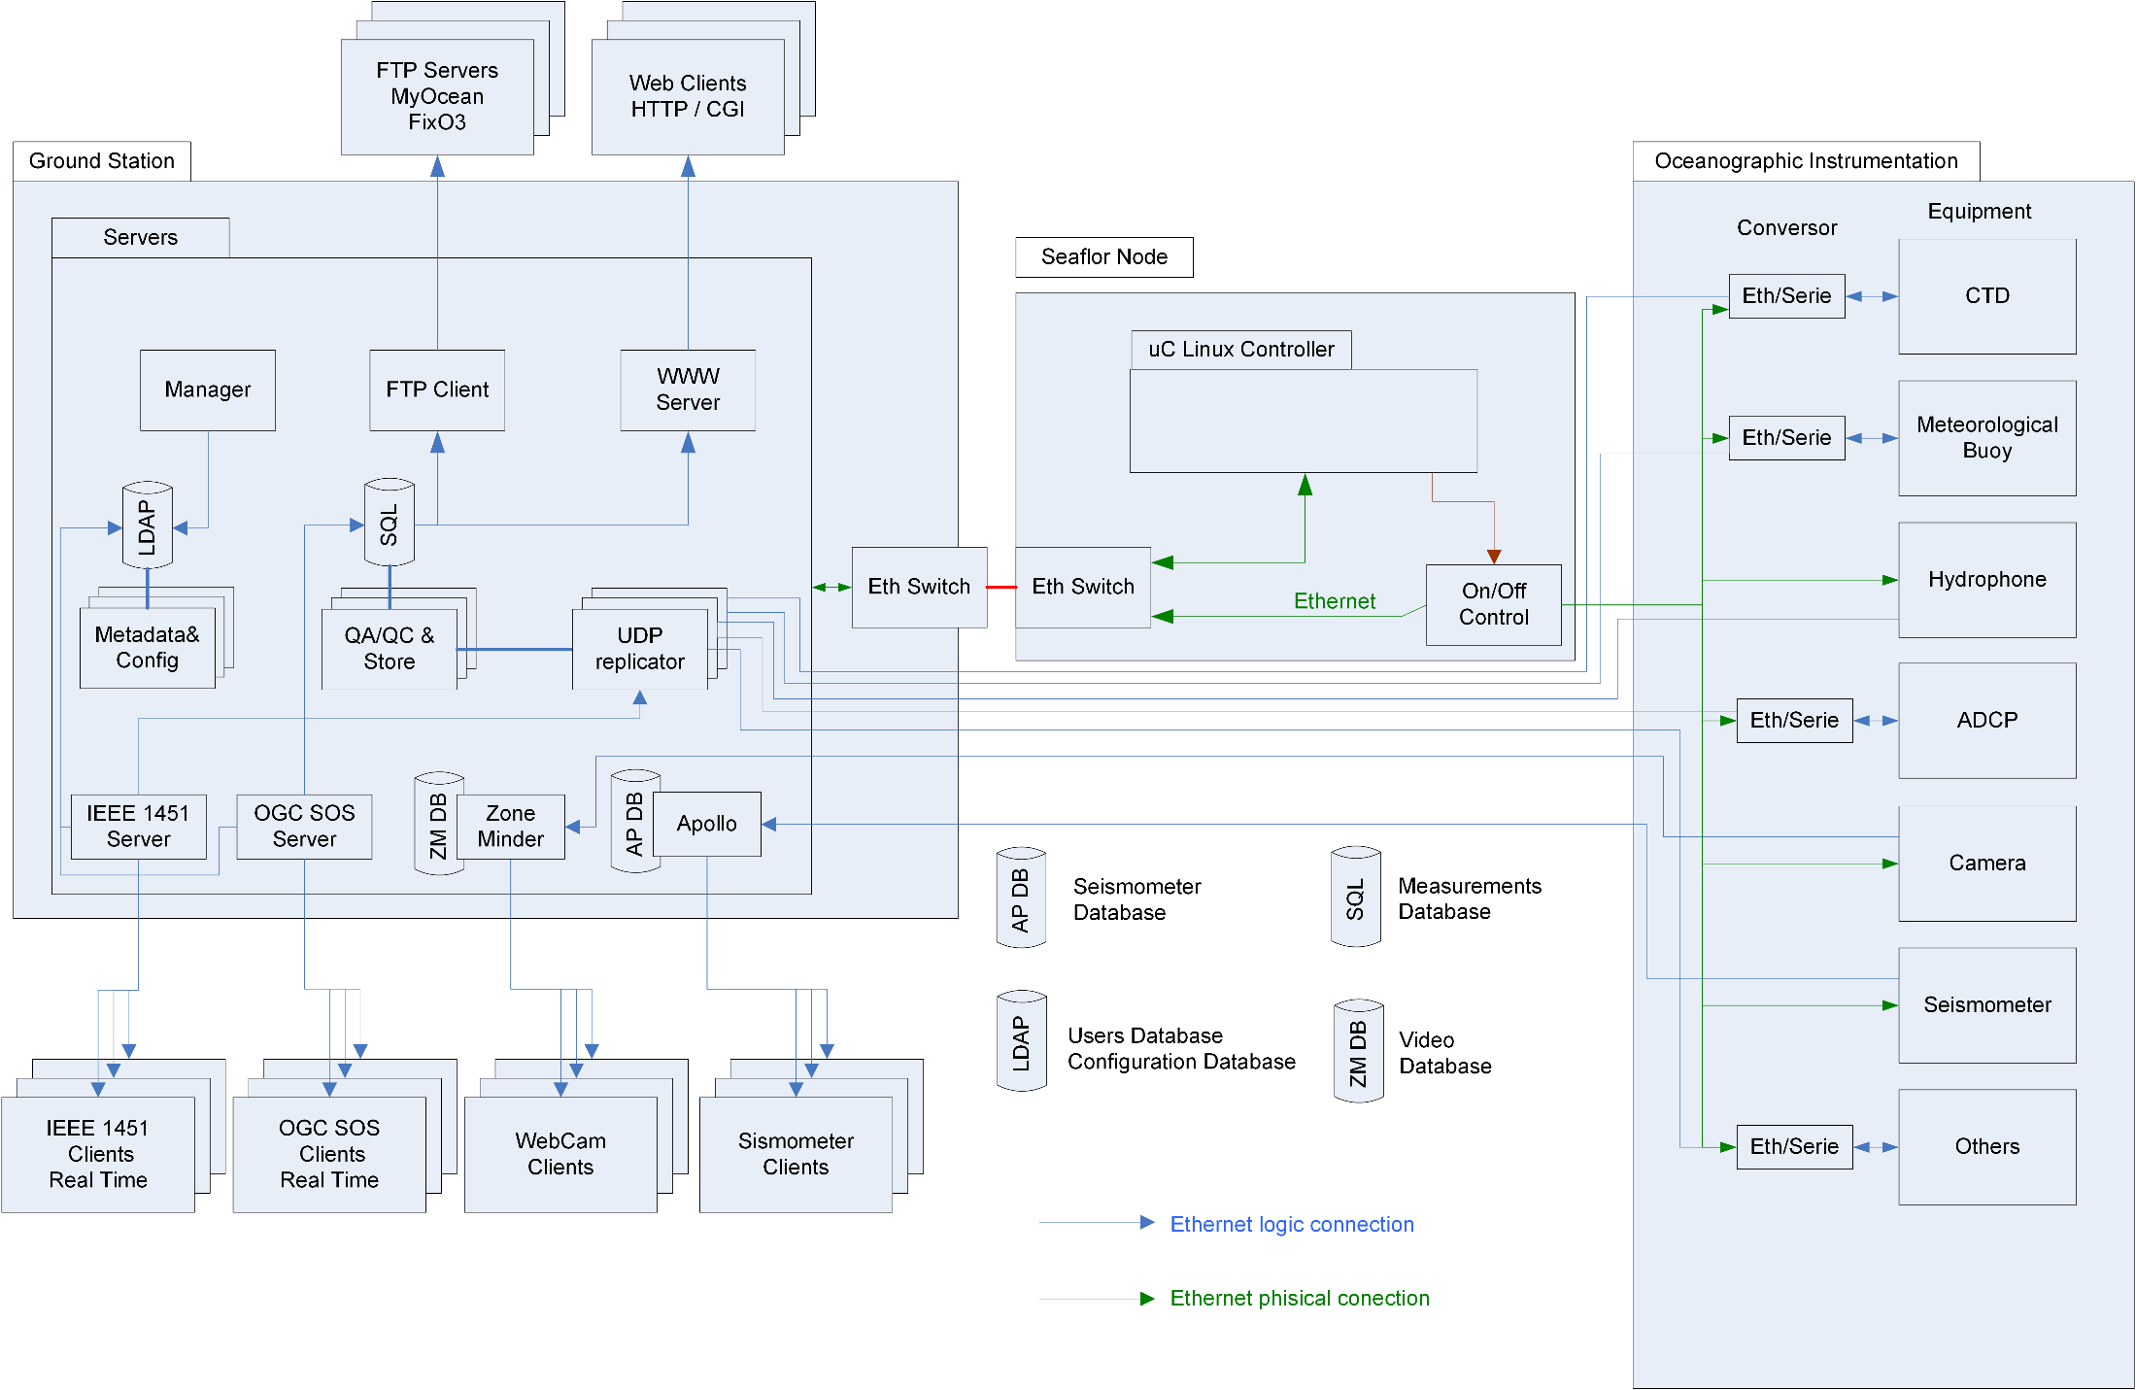
Obsea data services…

Slide 45
OBSEA QC Flags
Flag | Meaning
0 | no quality control
1 | value seems correct
2 | value appears inconsistent with other values
3 | value seems doubtful
4 | value seems erroneous
5 | value was modified
6 | flagged land test
7-8 | reserved for future use
9 | value missing

Slide 46
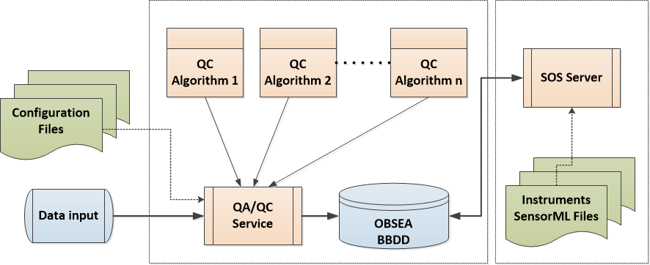
Flow of QC Service and SOS Server

Slide 47
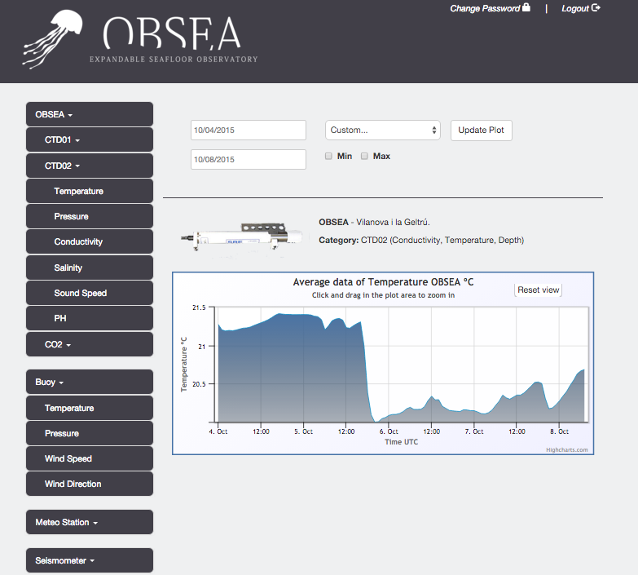
Obsea data – web site: www.obsea.es

Slide 48
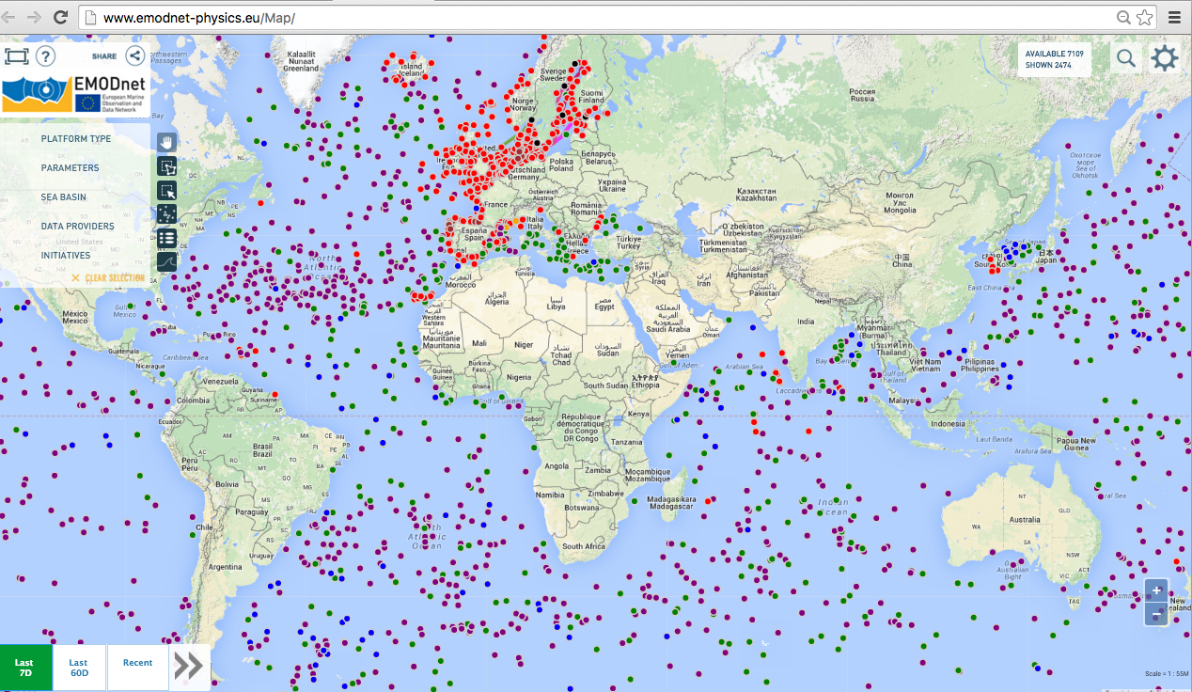
http://www.emodnet-physics.eu/Map/

Slide 49
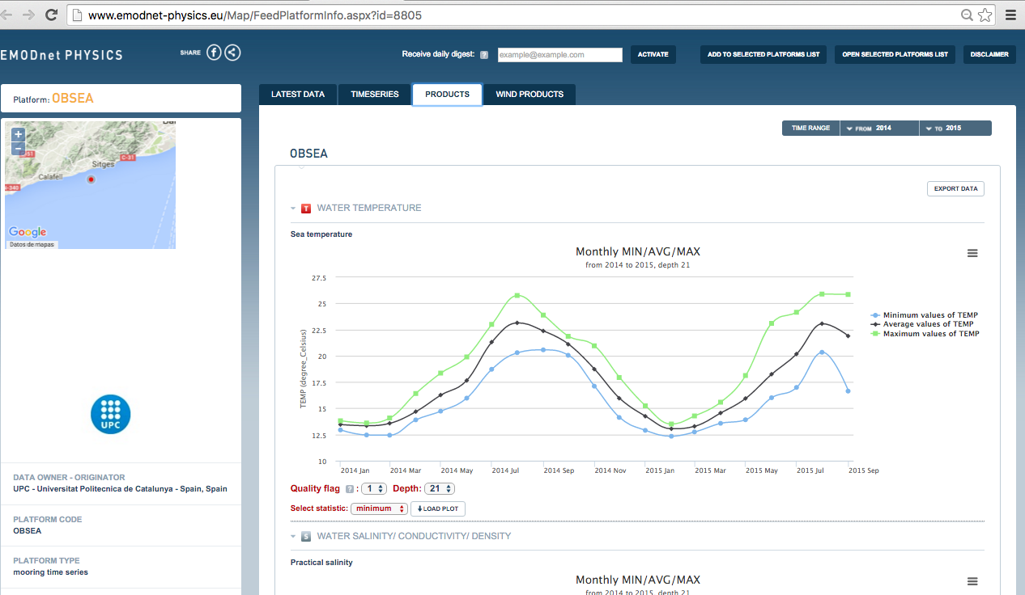
From Emodnet Physics: http://www.emodnet-physics.eu/Map/FeedPlatformInfo.aspx?id=8805

Slide 50
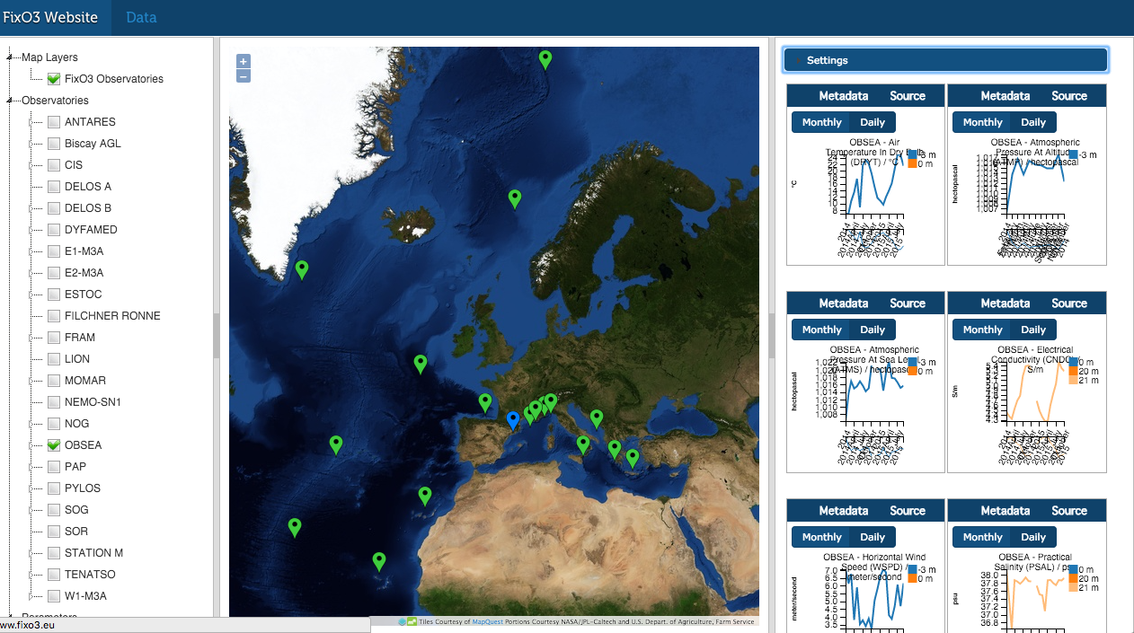
FixO3 Website: http://earthvo.fixo3.eu/

