Slide 1
The Eurofleets2 on board data management System (EARS)
“OGC SWE standards in Research Vessels Scenario”
Workshop Sensor Web Enablement (SWE) for oceanography, status of developments, international coordination and dialogue with industry, hosted by the EU-EuroFleets II project
Jordi Sorribas (UTM-CSIC, Spain)

Slide 2
The Research Vessel Scenario
1
How We Work …
What We Need …
2
What We Have (Eurofleets2 /SDN) …
In progress …

Slide 3
How We Work …
The Research Vessel Scenario

Slide 4
How We Work …
The Research Vessel Scenario
Data Centres
Big, big Volumes
Multilingual / Cultural
General Purpose (Underway)
Heterogeneity (structures)
Users
Onshore Users
Data
Crew
Onboard Scientists
Multi parameter &dimensional
Technicians
Ad-Hoc data acquisition Systems
Research Vessels
Fleet
Prototypes
Multi-Sensor
Different Countries
Instruments
Regional / Oceanic
Dynamic Composition
Georeferenced (platform/global)

Slide 5
What We Need …
Harmonisation of Data and Metadata
Jeff de La Beaujardière (OceanObs'09)

Slide 6
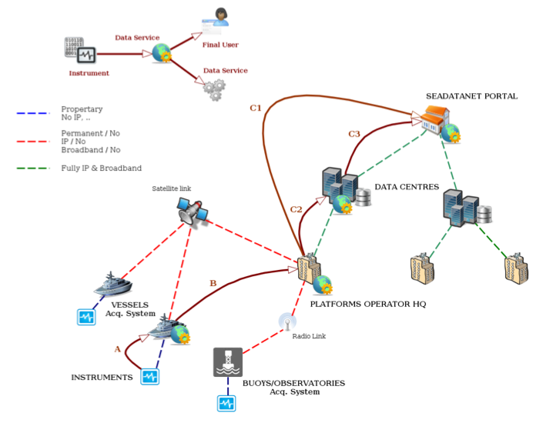
What We Need …
Networking
From Source to User

Slide 7
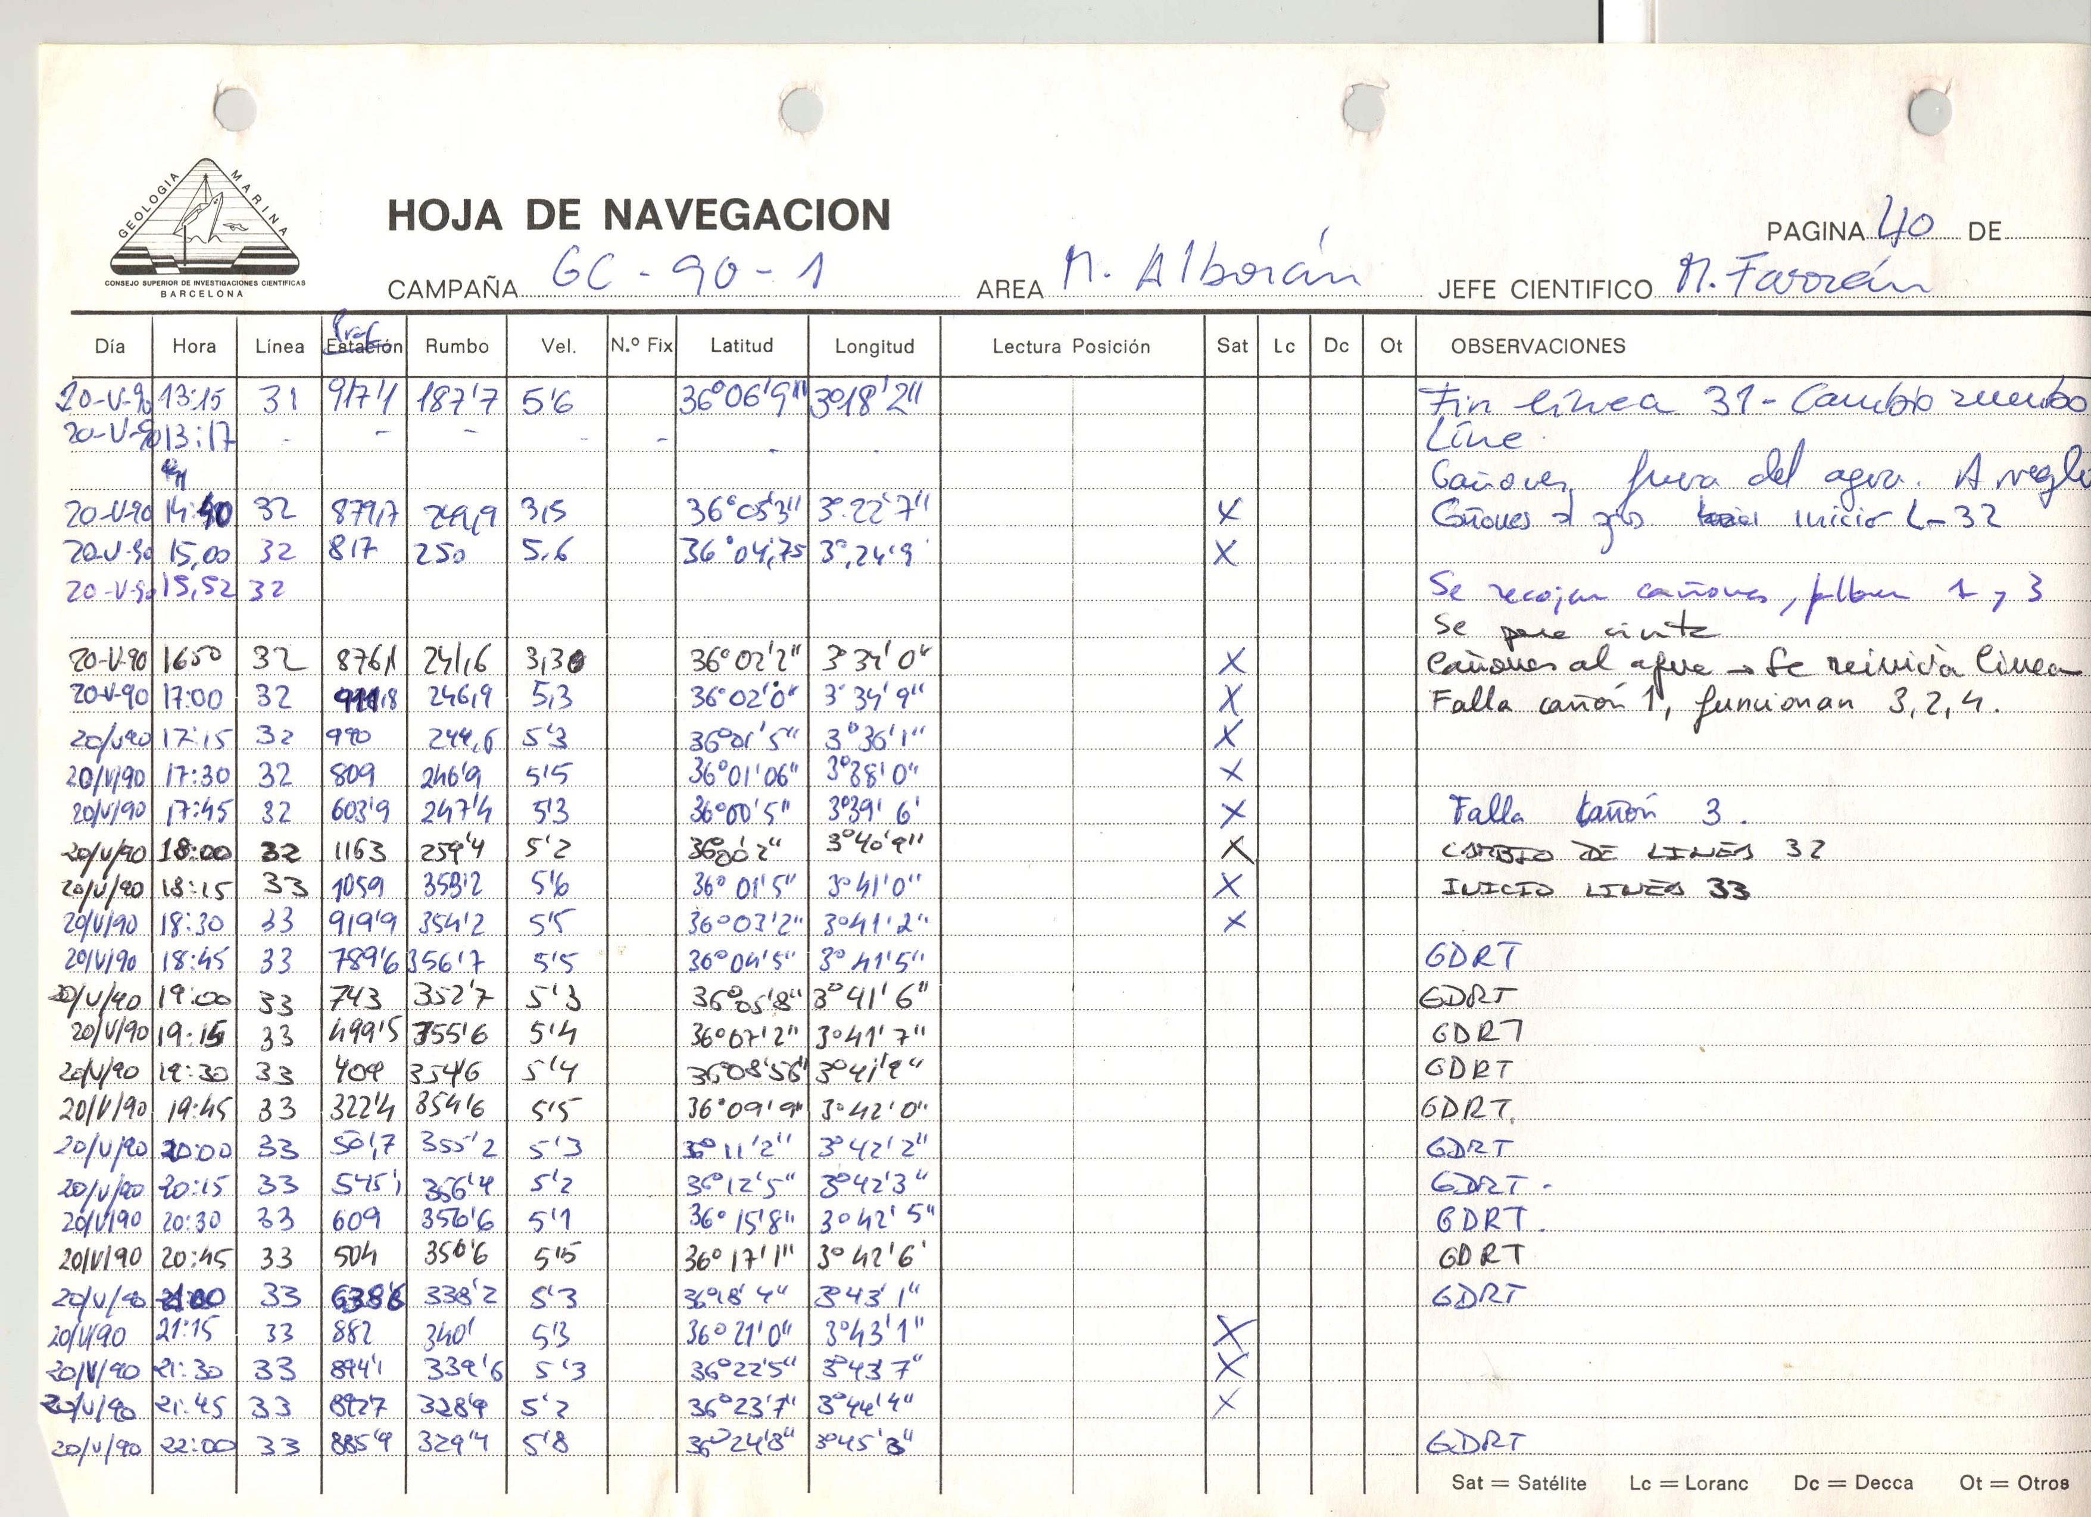
What We Need …
Log Books
DATA QUALITY

Slide 8
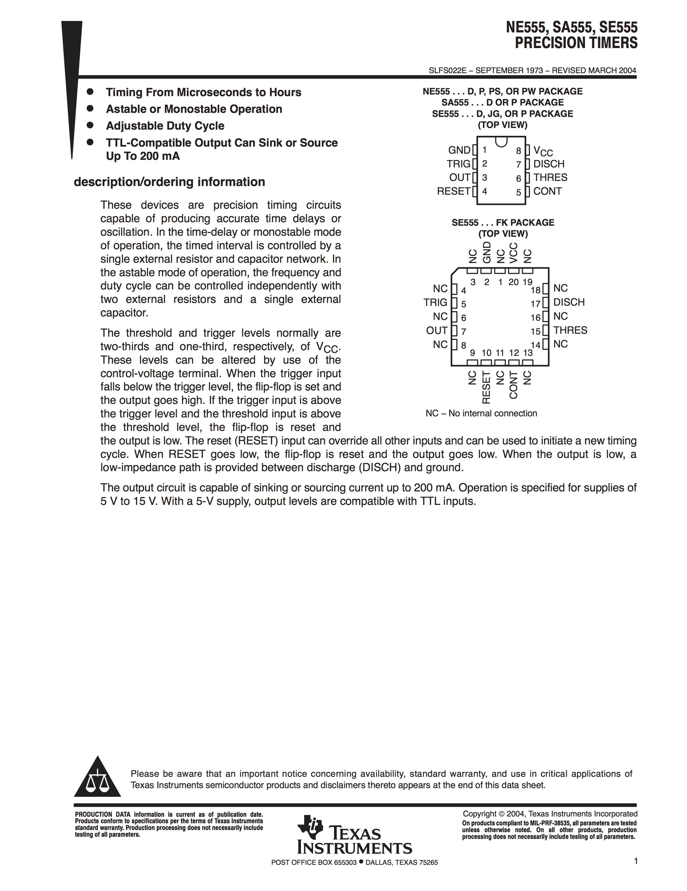
What We Need …
Good Instrument Descriptions
DATA QUALITY

Slide 9
What We Need …
Track Calibration Procedures
DATA QUALITY

Slide 10
What We Need …
Standardisation of The Instrument Conception

Slide 11
What We Need …
Data Access (Delayed & Real Time)
Data Search and Found
Integration WITH ExISTING STANDARDS

Slide 12
What We Need …
Metadata Harmonisation
common descriptors for …

Slide 13
What We Have …
Provide Common Tools, Protocols, Data and Metadata Formats for onboard users
Common standards (open and well extended)
Same procedures (user experience)
Facilitate data flow from vessels to data centres
Metadata at origin
Near Real Time

Slide 14
What We Have …
EUROFLEETS2 & SeaDataNet2 Developments
Motivation
Increase the level of information provided of the onboard systems
Instrumentation used
Instrument history
Calibrations / Configuration
Composition
Operation and Maintenance
Complex Data Structures
Use a common way to:
Access to Real Time Data / Historical Data
Access to Instrument Descriptions
Enhance existing Metadata descriptors
Common Data Index
EDIOS metadata
OGC SWE Adoption

Slide 15
What We Have …
EUROFLEETS2 & SeaDataNet2 Developments
Products
Adoption: Open Geospatial Consortium Sensor Web Enablement (SWE)
SensorML (Metadata)
O&M (Metadata & Data)
Sensor Observation Service - SOS (Data Service)
How SWE standards could be integrated into SDN2
SensorML and O&M profile for Research Vessels
SensorML and O&M profiles for Fixed Stations
Sensor Observation Service pilot implementations

Slide 16
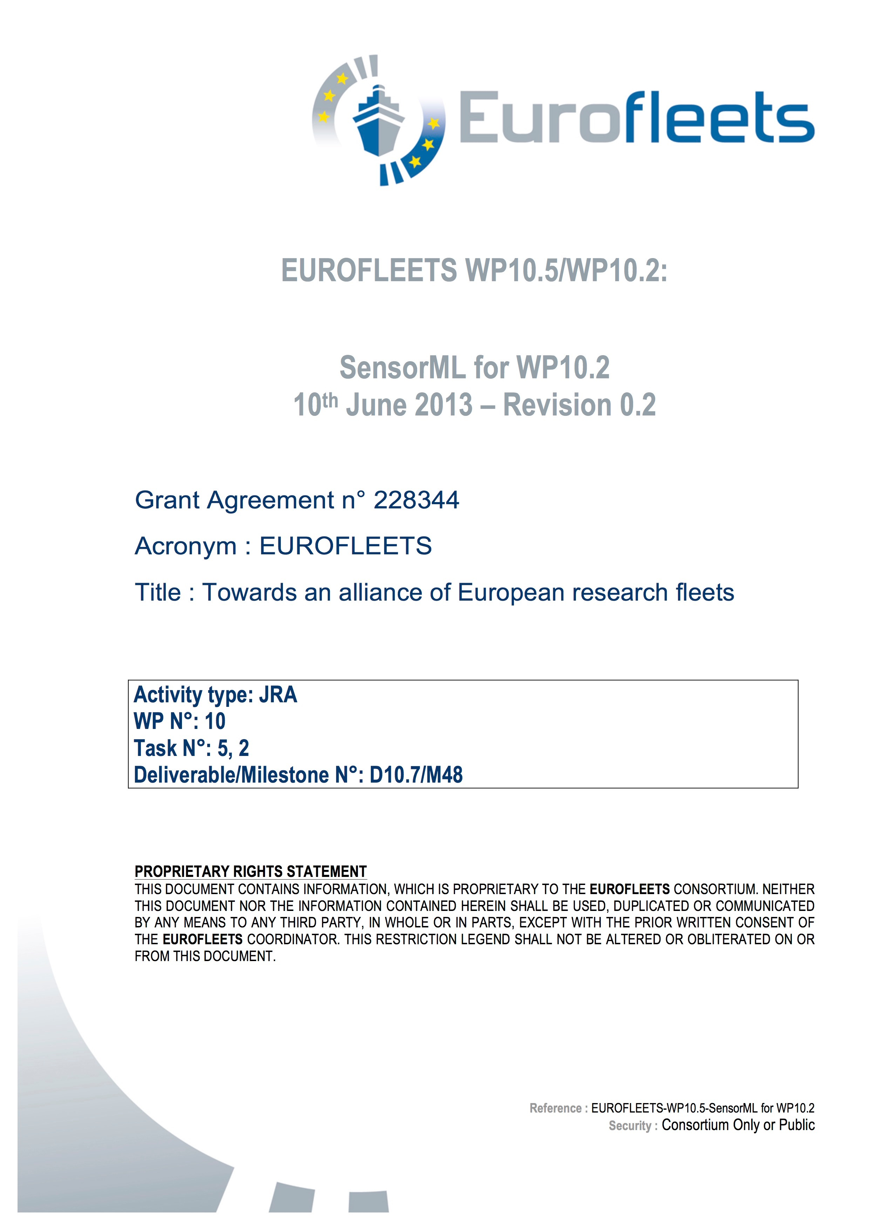
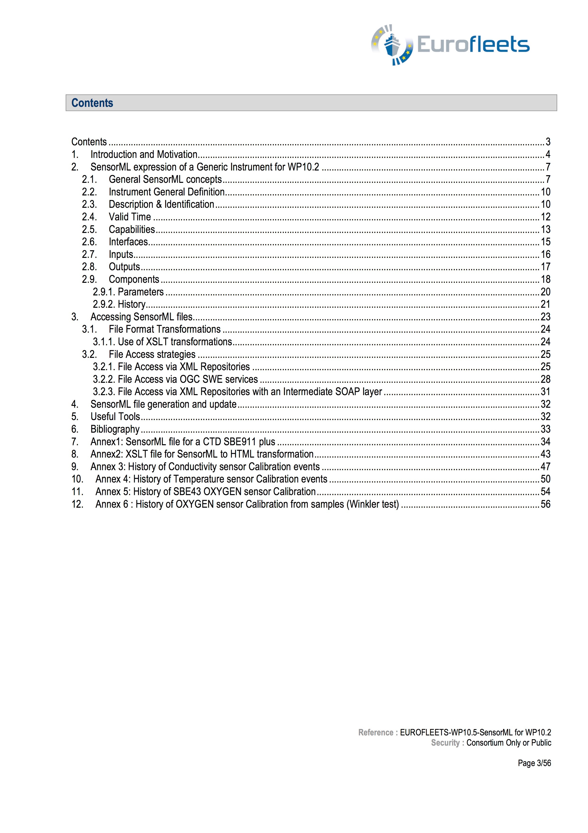
What We Have …
Eurofleets
(SensorML for Calibrations prove of concept)
Common Calibration Profiles for Eurofleets FP7 Project
Document

Slide 17
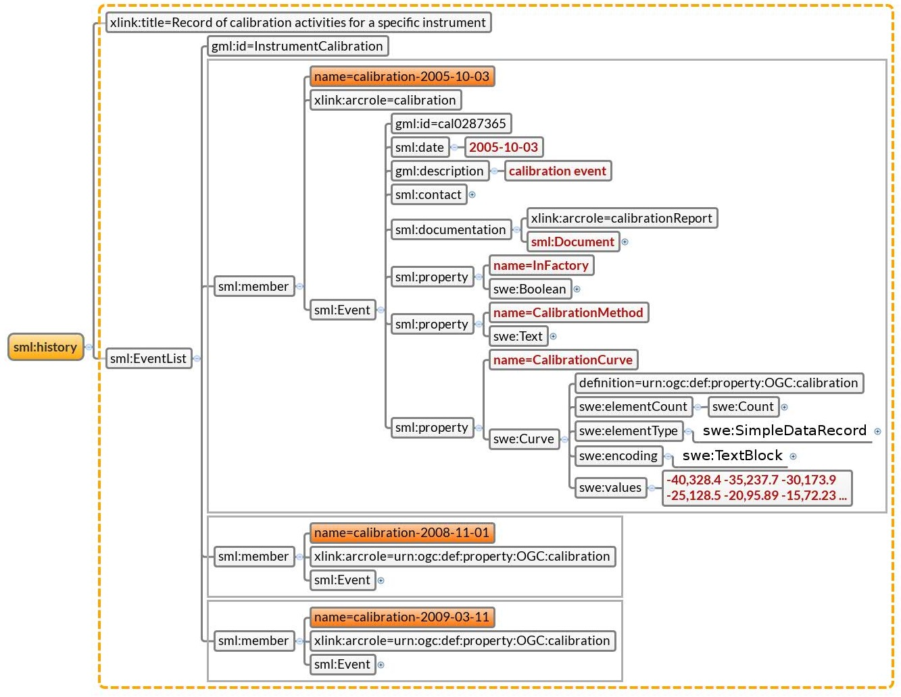
What We Have …
Eurofleets
(SensorML for Calibrations prove of concept)
Common Calibration Profile for CTD proves

Slide 18
What We Have …
EARS (Event Concept)
Among the many goals the EUROFLEETS projects have, a very important task is the development of an “event log software” called EARS (Eurofleets Automatic Reporting System) that enables scientists and operators to record what happens during a survey.
Events
“Dredge nº 123 has been reached to seafloor at 21:45:00”
21:45:00
+
Dredge
+
placed at
+
Seafloor
,
nº 123
Categories
Process
Tool
Action
Action
Tool
Action
Property
Property
“Related Controlled Vocabulary Terms” —-> ONTOLOGY

Slide 19
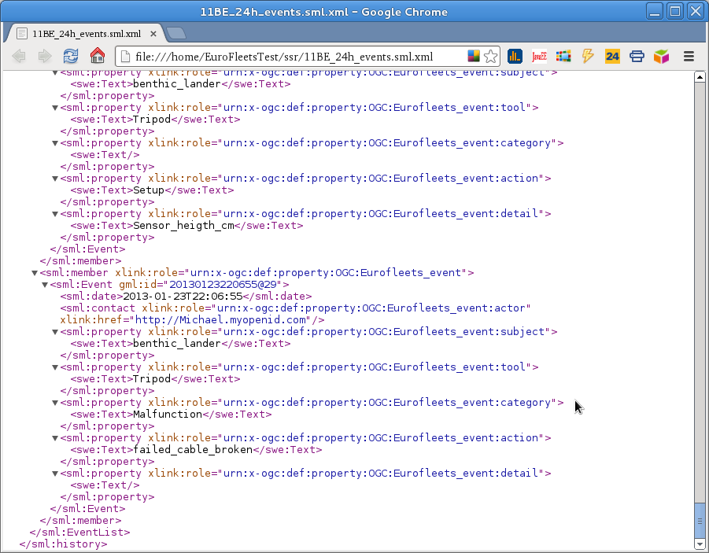
What We Have …
EARS (Event Codification SensorML)
Event History
Events

Slide 20
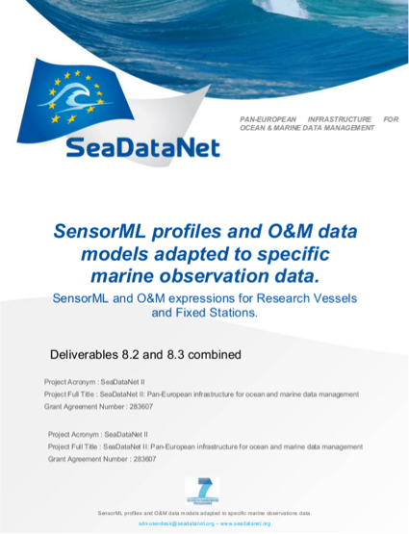
What We Have …
SensorML and O&M Profiles
Document

Slide 21
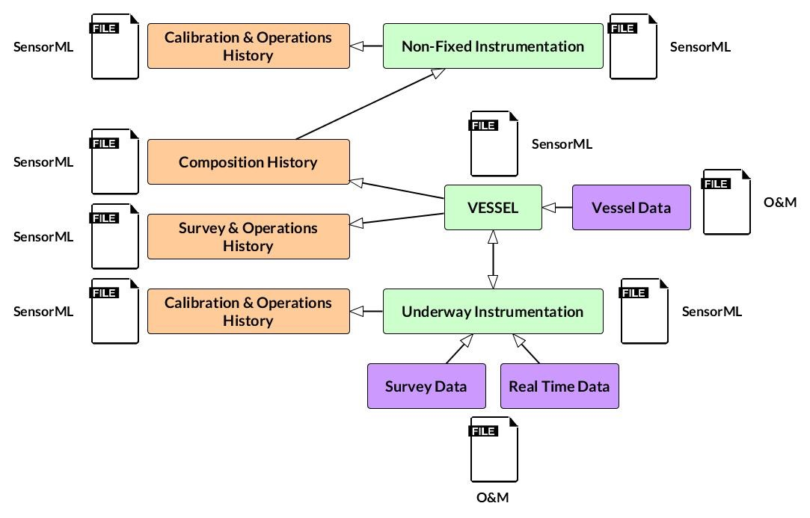
What We Have …
Vessel Profiles
http://www.utm.csic.es/SensorWeb/Descriptions

Slide 22
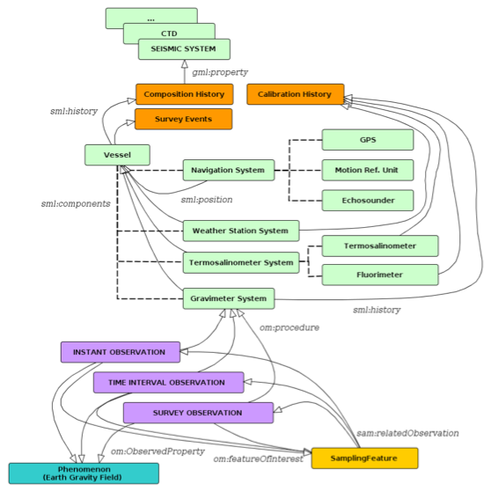
What We Have …
Vessel Profiles
http://www.utm.csic.es/SensorWeb/Descriptions

Slide 23
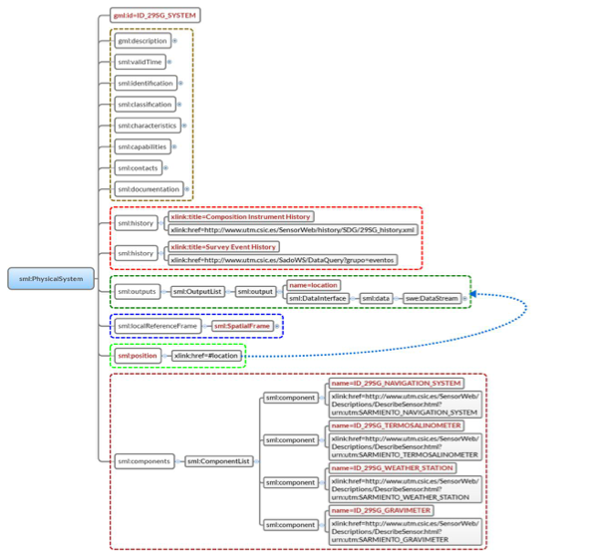
What We Have …
Vessel Profiles
General Info
Histories
DYNAMIC PARTS
Location
Fixed Instruments Composition

Slide 24
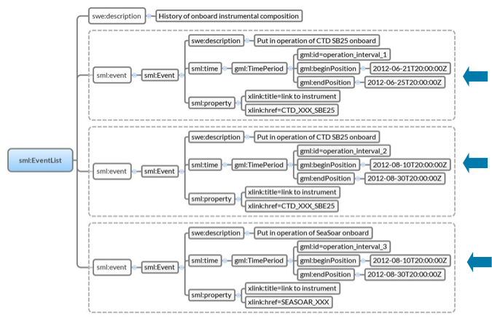
What We Have …
Vessel Profiles
Composition History

Slide 25
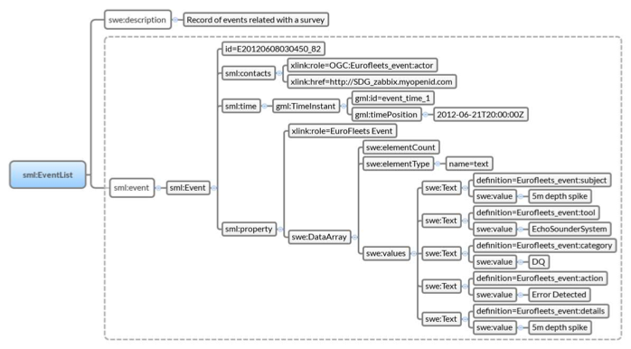
What We Have …
Vessel Profiles
Survey Events
History

Slide 26
What We Have …
Vessel Profiles
Instant - Time Interval - Survey Observations

Slide 27
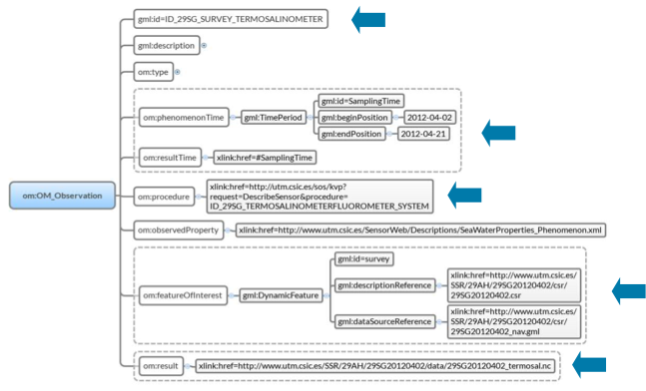
What We Have …
Vessel Profiles
Survey O&M profile for Underway Data

Slide 28
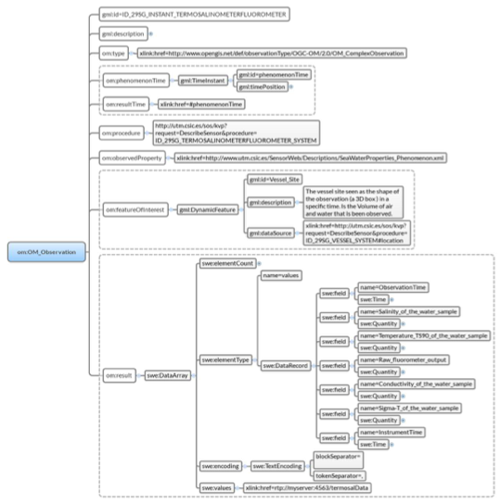
What We Have …
Vessel Profiles
Instant profile O&M for Underway Data

Slide 29
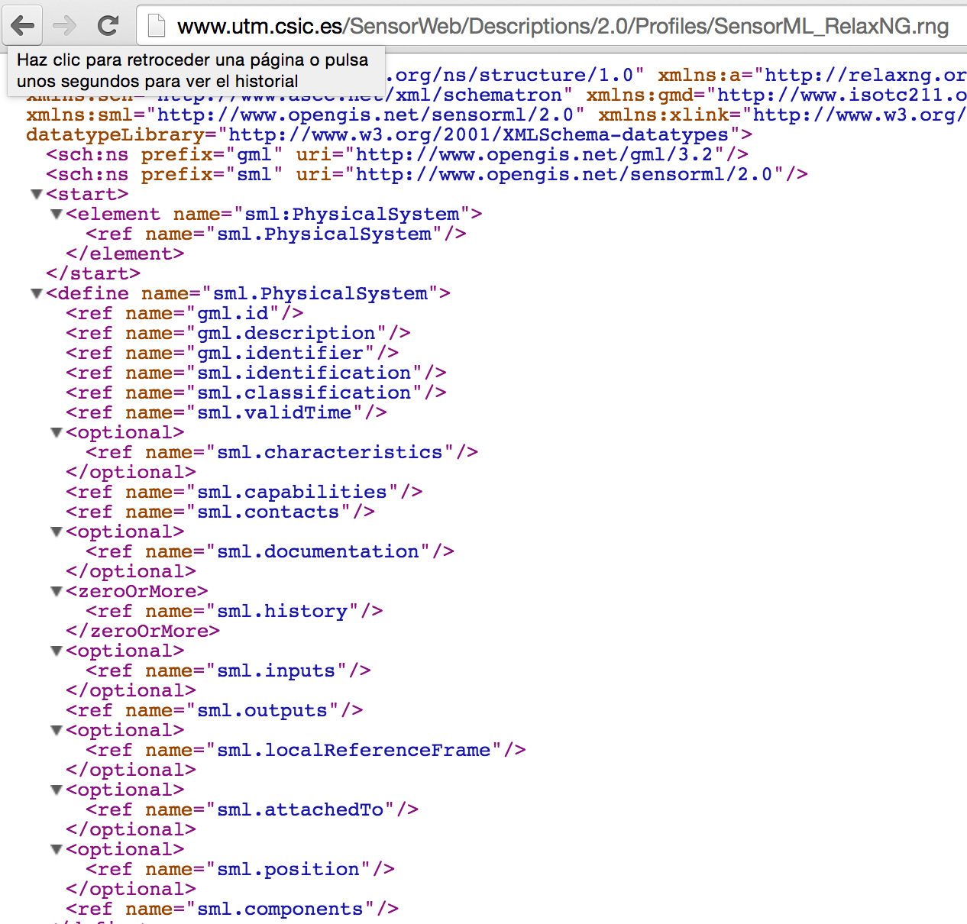
What We Have …
Vessel Profiles
Relax Schemas
- RELAX NG language is very simple, the syntax is intuitive.
- Using RelaxNG + Schematron we will apply ISO/IEC 19757.
- RELAX NG schema makes sure that all the required elements and attributes are present, and that some of these have the correct datatype.
- Embedding Schematron rules in RELAX NG is very simple

Slide 30
What We Have …
Metadata and Data Access Harmonisation
Two families of standards (ISO - OGC)
Common Data Index CDI (metadata about Data Sets)
Cruise Summary Reports CSR (metadata about Cruises)
what-how-where-when-who-….

Slide 31
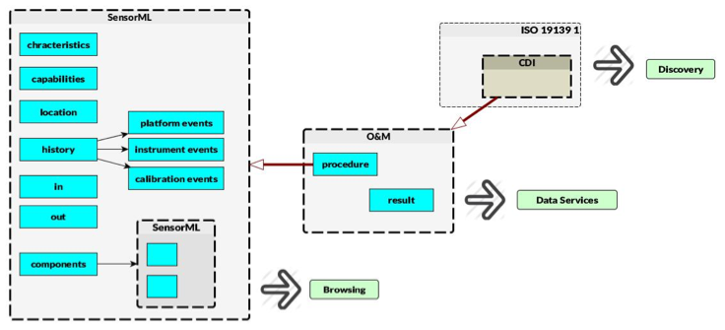
What We Have …
Integration with SeaDataNet
Connection
Metadata and Data Sets at NODCs
Common Data Index - O&M - SensorML

Slide 32
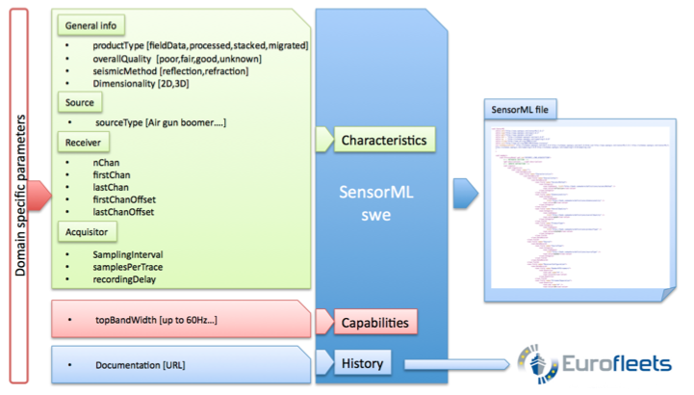
What We Have …
Integration with SeaDataNet
GeoSeas (Seismic example)

Slide 33
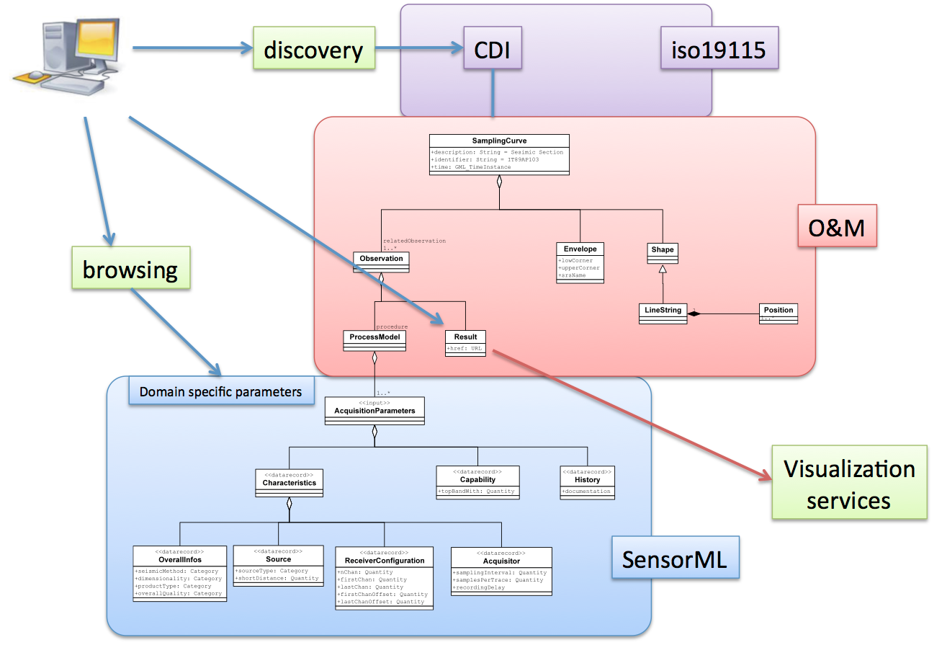
What We Have …
Integration with SeaDataNet
Integration with existing SeaDataNet Standards
1
2
3
4
Diviacco, P. et al. 2011 Marine Seismic Metadata for an Integrated European Scale Data Infrastructure

Slide 34
In progress …
How to implement SWE SOS with all this
SensorML descriptions
Allow dynamic content in some parts:
Vessel position (reference for rest of instruments)
Survey Events (complete history, survey history)
Create Files Onboard and then Populate Content from Vessel to Shore - “Metadata creation as close as possible from the moment of data acquisition”
Easy creation for non expert users (non SOS skilled)
Integrated with existing user tools
User Logbooks
Monitoring systems. Automatic events
Maintenance software. Calibration and Instrument Composition

Slide 35
In progress …
How to implement SWE SOS with all this
O&M descriptions and Data Access
Integration with Existing data Acquisition Systems
Maintain as simple as possible systems on board
Avoid Duplicate Data Bases
Allow easy integration of new and non-simple data structures (prototypes)
Create Files Onboard and then Populate Content from Vessel to Shore - “Metadata creation as close as possible from the moment of data acquisition”
Data vessel to shore. As less payload possible (Satellite Comm)
Harmonisation with Metadata Files (CDI) at NODCs

Slide 36
In progress …
SWE SOS Service onboard/onshore ?
SOS components implemented in close connection with “Ifremer: Data Acquisition Software Proto" (Eurofleets2 wp13. Software and Tools):
SOS supporting SensorML 2.0
SOS KVP expression: very simple, the syntax is intuitive.
SOS integrated into onboard Data Acquisition Software
Existing Data Acquisition DB and infrastructure
Underway Instruments. RT Data.
Populate Onboard Infrastructure to shore

Slide 37
In progress …
SWE SOS Service onboard/onshore ?

Slide 38
In progress …
SWE SOS Service onboard/onshore ?
SOS Prototype at CSIC: Self implementation (a working evaluation to be used in Euf2 Proto)
Data service

Slide 39
In progress …
SWE SOS Service onboard/onshore ?
CAPABILITIES
http://www.utm.csic.es/sos/kvp?service=SOS&request=GetCapabilities
DESCRIBE SENSOR
Navigation System
http://www.utm.csic.es/sos/kvp?service=SOS&request=DescribeSensor&procedure=ID_29SG__NAVIGATION_SYSTEM
Weather Station
http://www.utm.csic.es/sos/kvp?service=SOS&request=DescribeSensor&procedure=ID_29SG_WEATHER_STATION
GET OBSERVATION
Navigation System
http://www.utm.csic.es/sos/kvp?service=SOS&request=GetObservation&procedure=ID_29SG__NAVIGATION_SYSTEM Weather Station
http://www.utm.csic.es/sos/kvp?service=SOS&request=GetObservation&procedure=ID_29SG_WEATHER_STATION

